Slide 1
5th and 14th Amendments
1/16/15

Slide 2
Bell Ringer
Silently answer the question below in at least 5 sentences:
Do you think that every citizen of the United States is treated equally under the law? Explain your answer.

Slide 3
Today’s Objective
SWBAT explain how due process connects to current events.

Slide 4
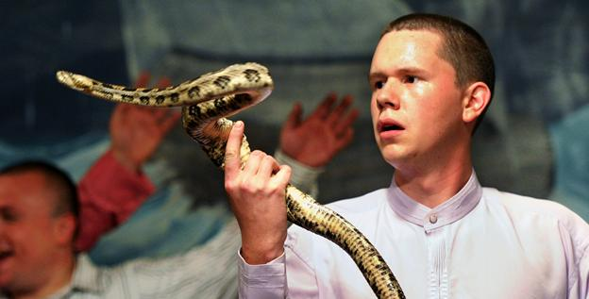
Snake Handling: Individual Liberties Vs. Public Safety
https://www.youtube.com/watch?v=cwBVcsWYJd8

Slide 5
5th and 14th Amendments
“…Nor shall any State deprive any person of life, liberty, or property, without due process of law; nor deny to any person within its jurisdiction the equal protection of the laws.”

Slide 6
Case Study Investigation
4 stations @ 14 minutes each
4 court cases
1 big question: are ALL people treated fairly under the law?
Key Vocabulary:
Perpetrator
Victim
Indict
Plea

Slide 7
Question 1
If there is not enough evidence…
Is it better to send an innocent man to prison, or set a guilty man free

Slide 8
Exit Slip Question
Connect one of the cases you read about to due process.

