Slide 1
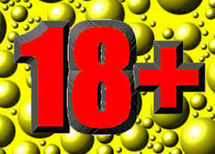
An act to lower the drinking age to 18
Keshun Byrd
Donte’ Harris
February 4, 2015
4a

Slide 2
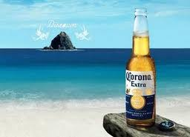
SECTION 1
The definition of a drinking age is the minimum age at which it is legal for a person to buy alcohol. The age at which is legal for a person to buy alcoholic beverages.

Slide 3
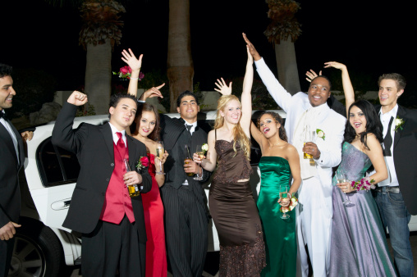
SECTION 2
I think the bill should be pass because teens drink under-age because they have to wait so long to be legal to drink. Another reason is it would cause teens to be more responsible. Teens would not have to sneak to drink and that usual lead to them doing crazy things.

Slide 4
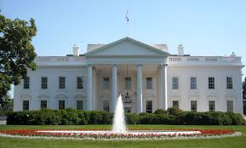
SECTION 3
This bill should be pass because people want to have fun. When you are at prom in the 12th grade you would like drink and go crazy. But you’re not 21 so your underage drinking. If you can just give they could just give us one chance to prove that we are responsible and trustworthy then he can pass the law of drinking at the age of 18. It’s going to take hard working and some thinking to get everybody in the world to agree about this. We should sit down when the president talk to him about this. We can get on national broadcast television and make an announcement saying, “We are trying to get everyone that’s 18 or older to vote on passing the law of drinking at the age of 18”.

Slide 5
SECTION 6
The bill of lowering the age at 18 will be passed 30 days after the president signs and approve this bill.

Slide 6
SECTION 7
The legislature of the United States hereby finds, determines and declares that this ACT is necessary for the preservation of public health, peace and safety.

