Slide 1
AP Human Geography Unit 3
Folk and Popular Culture

Slide 2
Bell Ringer- 10 minutes
One word is highlighted on your unit 3 vocabulary matrix.
Take a notecard and do the following with your word:
Describe (NOT DEFINE) it
Give an example
Draw an image

Slide 3
Habit Vs. Custom
Habit- the repetitive action of one person
Custom- the repetitive action of a group of people

Slide 4
Habit or Custom?

Slide 5
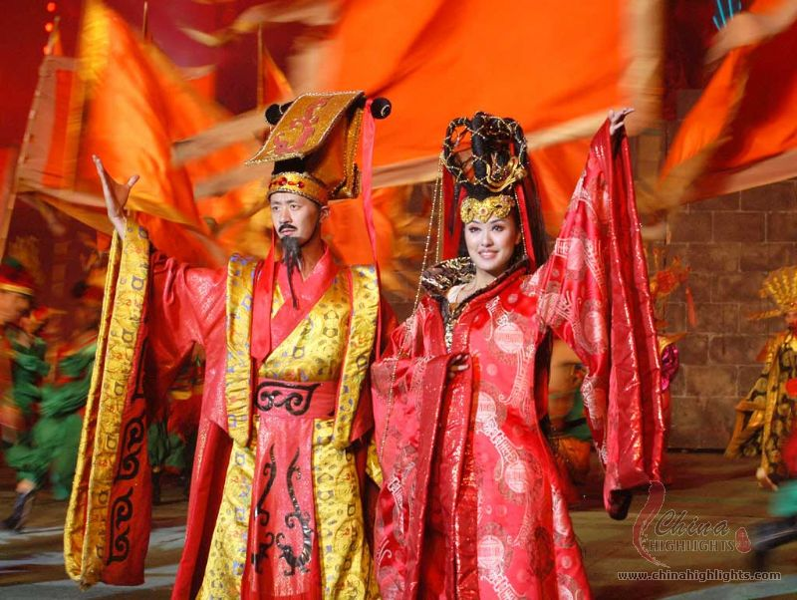
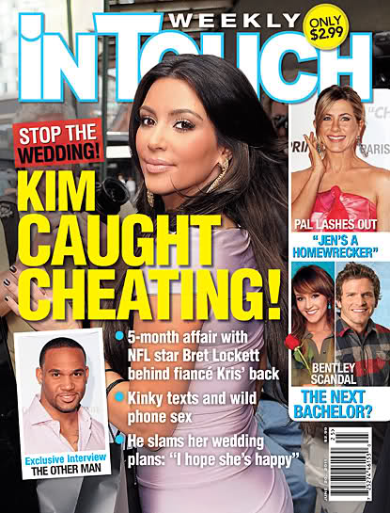
Folk Vs. Popular Culture
Folk Culture: traditionally practice by small, homogeneous groups living in isolated areas.
Popular Culture: Large heterogeneous societies that share certain habits despite differences in other personal characteristics.
https://www.youtube.com/watch?v=W3aRr4Ig7Rk

Slide 6
Folk and Popular Culture Origins:
Folk- Usually originates from an unknown date and hearth, or from multiple hearths
Popular- Usually from developed countries, traced to a specific origin

Slide 7
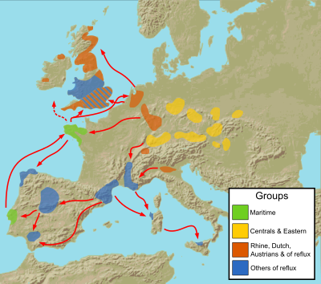
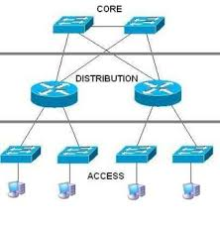
Diffusion
Folk- diffuses slowly and on a smaller scale than popular culture
Popular-usually diffuses hierarchically, spreading faster from hearths of innovation with the help of modern communication

Slide 8
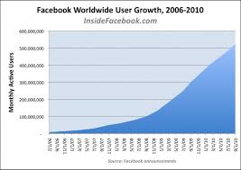
Distribution
Folk- Locally distributed, little access to the information. Local physical and cultural factors are a big influence.
Popular- Widely distributed across many countries, without little regard for physical factors. Access to the information is very wide.

Slide 9
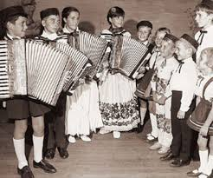
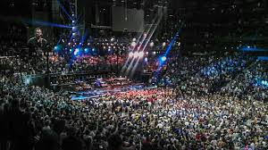
Music
Folk Songs: usually for a specific purpose (celebrations, religious, local daily life) or are tied to one specific place
Popular songs: Usually for entertainment and very widespread. Usually highest attended music festivals are in Europe and the United States.

Slide 10
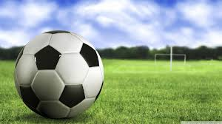
Sports
Soccer: Folk or Popular?
https://www.youtube.com/watch?v=le2e0pY0ekA

Slide 11
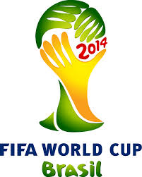
Evidence of Soccer as Popular Culture
Standardization of rules
Common name (except in USA)
Diffusion started in the British Empire, which is a developed nation
Diffusion worldwide and emergence of the World Cup

Slide 12
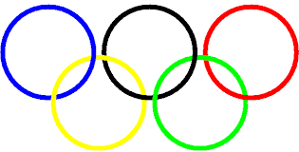
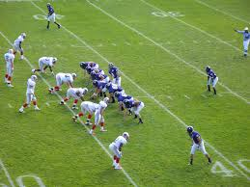
Olympic Sports
Requirements:
Played on 4 continents
Played in 75 countries for men (50 for women)
Summer Olympics 2016 features 28 sports but the leading two sports in the USA, football and baseball, are not included. Does this make them folk sports?

Slide 13
Surviving Folk Sports
Cricket- United Kingdom, South Asia, South Pacific, and Caribbean
Wushu- Martial arts in China
Baseball- Japan and North America
Football- United States and Australia
While these sports might be contained to one region of the world, mass communication systems and viewership have made them spread widely throughout their respective regions.

Slide 14
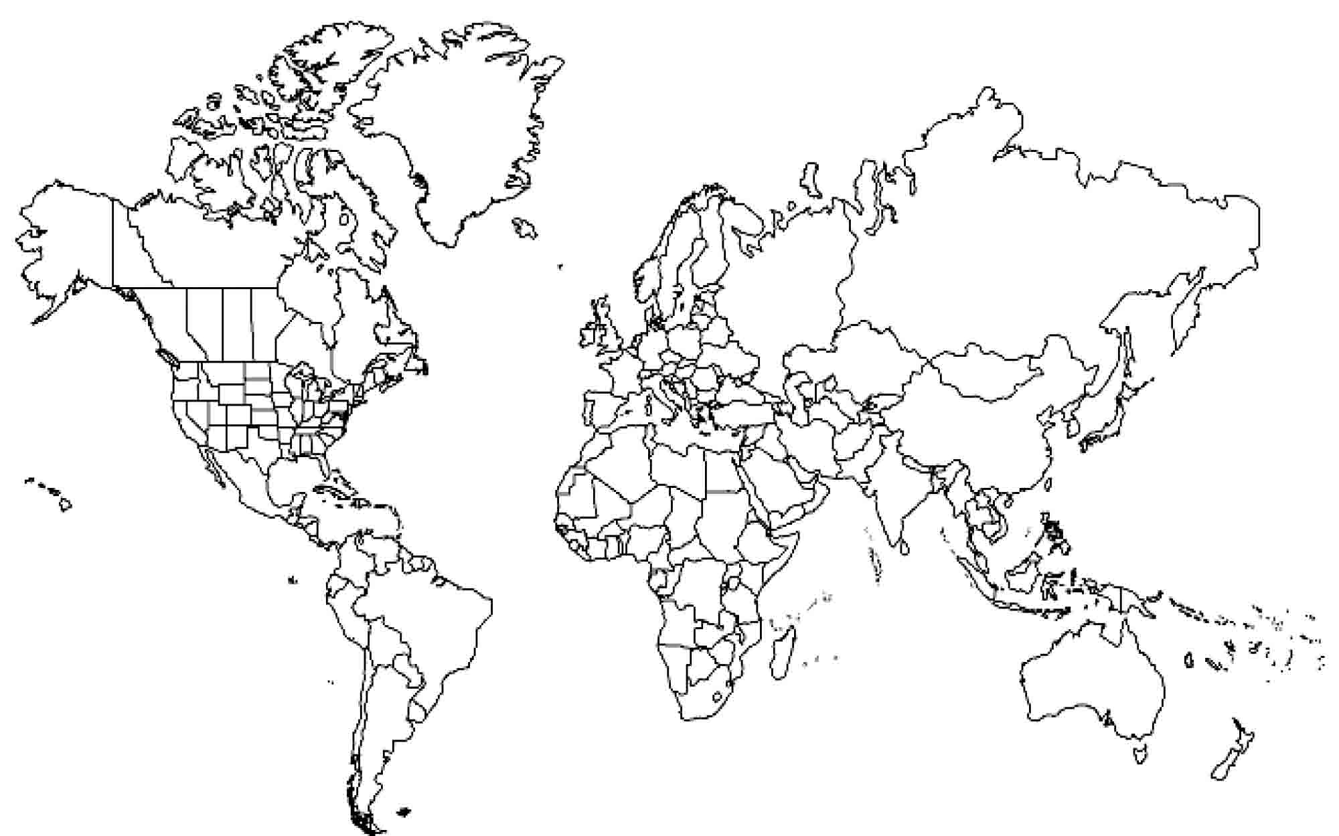
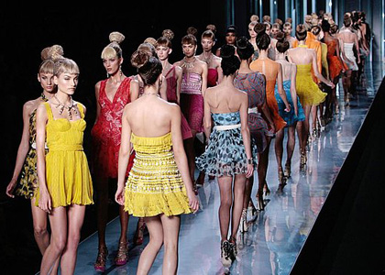
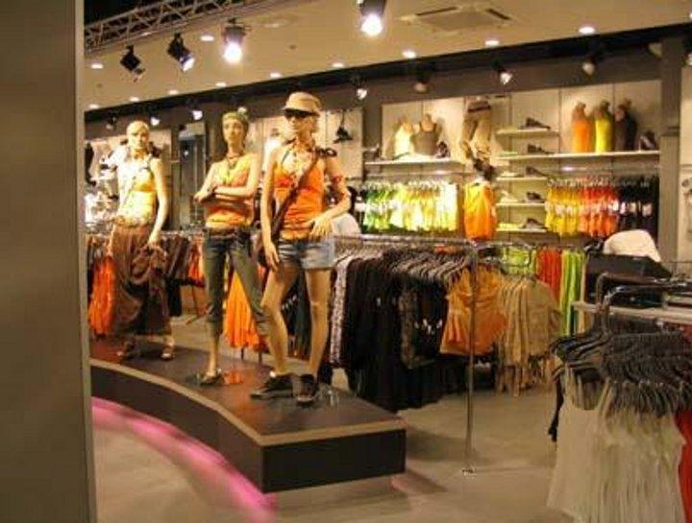
Popular Cultural Diffusion: Fashion Trends

Slide 15
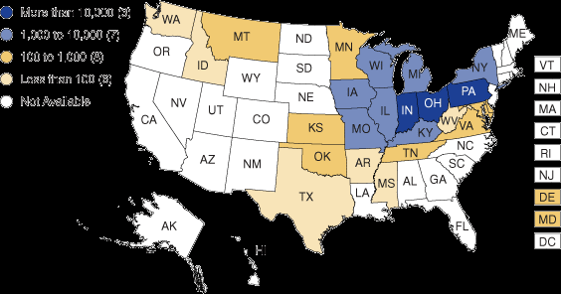
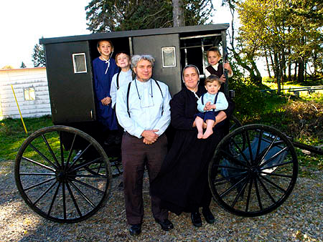
Local Folk Culture: The Amish
http://www.countryfarm-lifestyles.com/amish.html#.VCFUdJRdWSo

Slide 16
Video Example
Who
What
When
Where
Why

Slide 17
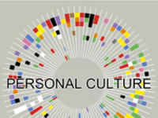
Personal Culture
Body Biography:
Draw follow these directions:
Head- what do you believe in or think about
Eyes- what do you see, what kinds of people do you see mostly?
a stick figure and Hands- what do you do, what hobbies do you have, what are your leisure activities
Mouth- what languages do you speak, how do you communicate?
Stomach- what / where do you eat? What do you wear?
Feet- what are your goals? What do you want to do? Where do you want to go? Where have you been?
Then, write down if you think you are a member of popular culture of folk culture and why.

Slide 18
Homework
1. Interview a parent, guardian, relative, or close adult in your life on their culture. Ask them at least 5 questions. Record (on you phone) or write down exactly what they answer.
2. Sort their answers into folk or popular culture in a T chart.
3. Write 1 paragraph explaining why you think they have this particular culture and analyze your findings.

