Slide 1
Asia
11/10/14

Slide 2
Unit 5 Exams

Slide 3
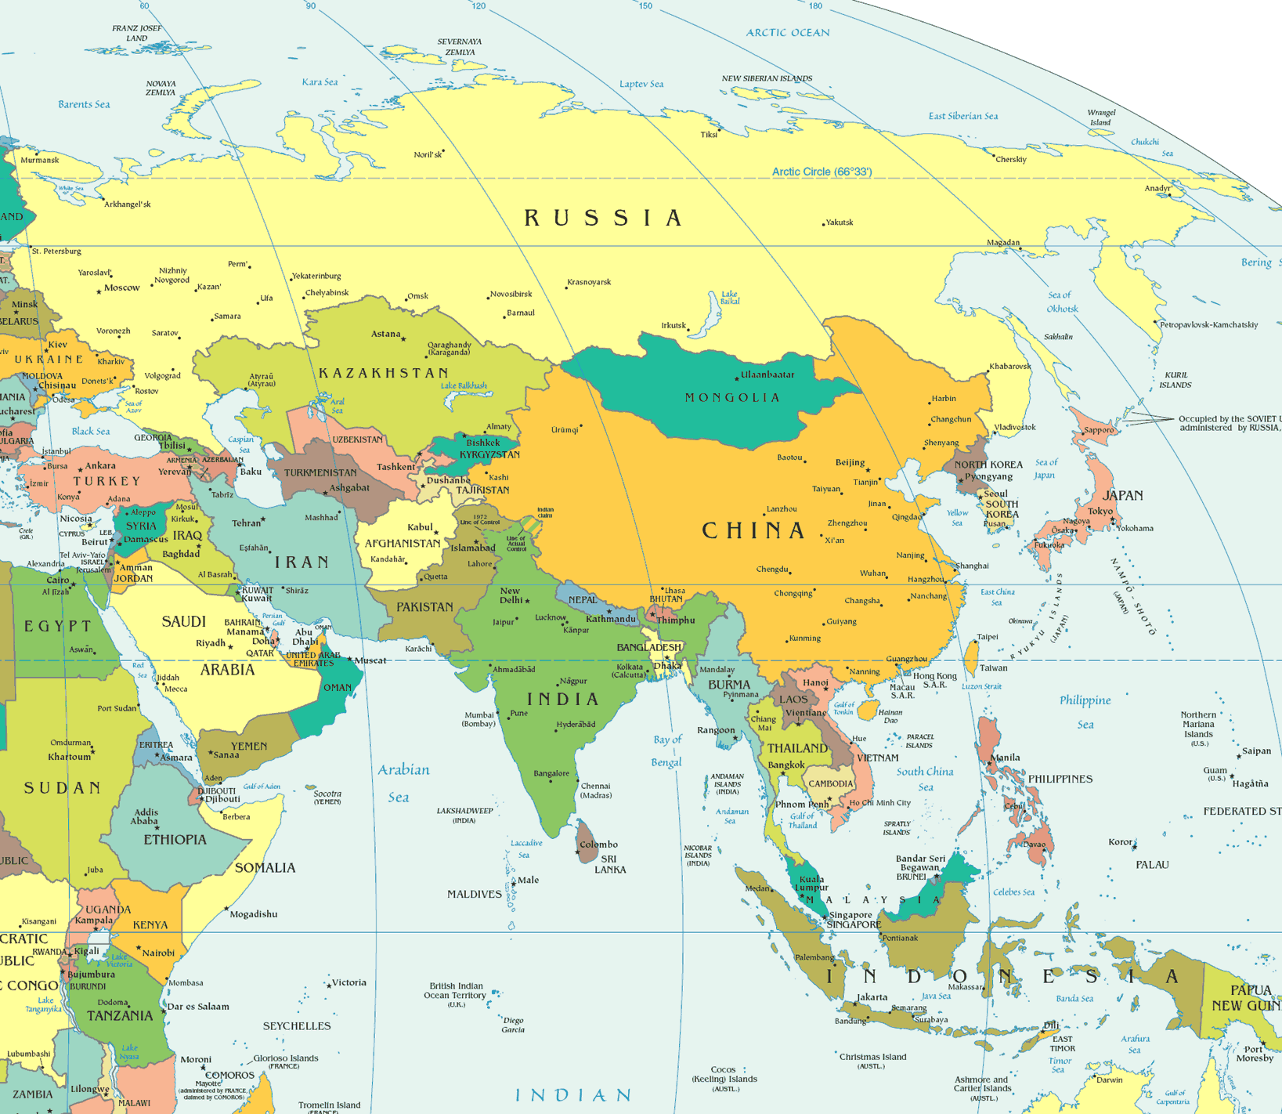

Slide 4
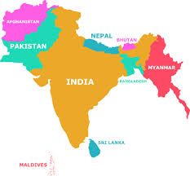
South Asia
Subcontinent because it is
geographically distinct
from the rest of the continent
Consists of 7 countries: India, Pakistan, Bangladesh, Maldives, Bhutan, Sri Lanka, and Nepal
Separated from the rest of Asia by mountains

Slide 5
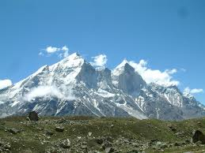
South Asia
Physical Geography: Consists of mainly plains and Plateaus
Himalaya Mountains (Home of Mt. Everest)
Turn to pg. 583 to compare Himalayas and Rockies

Slide 6
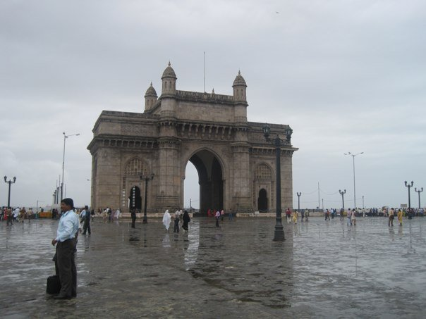
India- Mumbai

Slide 7
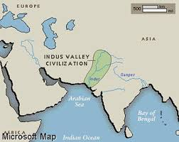
Physical Geography
Fertile plains at the foot of the Himalayas
Watered by the Indus, Ganges and Brahmaputra river valleys
Indus Valley is the home of one of the worlds earliest civilizations, Mesopotamia.

Slide 8
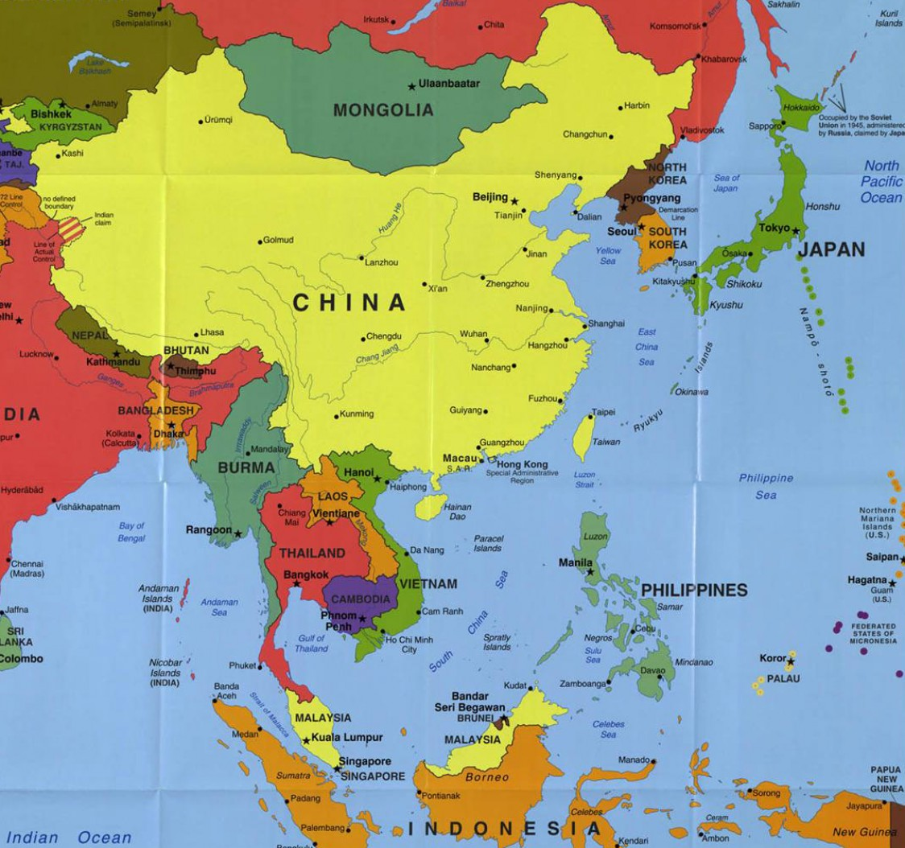
Asia
North and East of South Asia

Slide 9
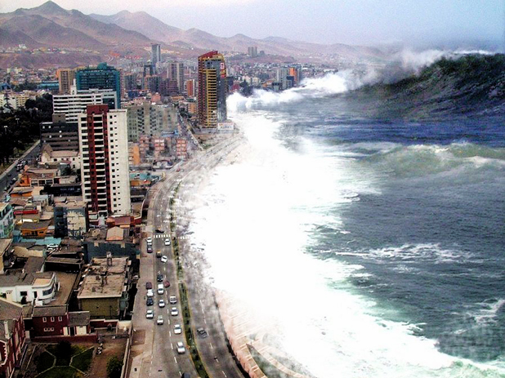
Physical Geography
Ring of Fire- Islands east of China
Frequent Earthquakes and volcanic eruptions
Volcanic eruptions caused most of the mountainous islands
Undersea earthquake → Tsunami

Slide 10
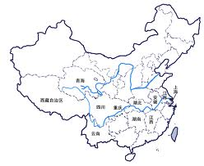
Physical Geography
China’s Rivers
-Huang He River (yellow river)- carries Loess or yellowish brown topsoil
Yangtze River- Asia’s longest River at 6,380 miles long
Xi River (West River) → most important river because of fertile lands surrounding it

Slide 11
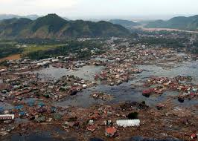
Climate in Asia
Heavy monsoon season
Can be devastating to
the area
Tsunamis caused by
Undersea earthquakes
Climates pg. 587 and 668

Slide 12
Did You Know….
In China, each family is only allowed to have ONE baby!!!

Slide 13
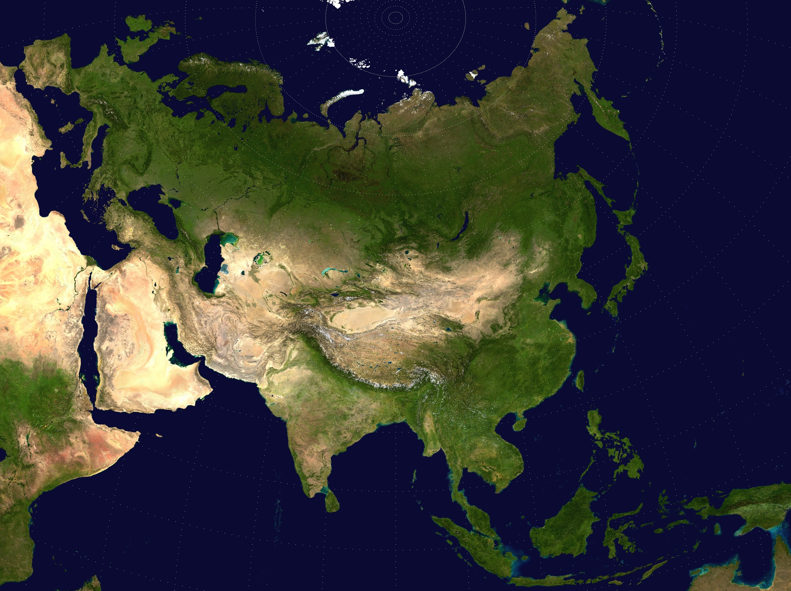
Effects of Physical Geography
Population Increase and less natural resources
Natural disasters

Slide 14
One Child Policy
https://www.youtube.com/watch?v=NlgYXaIdr7E
https://www.youtube.com/watch?v=StdqGoezNrY
https://www.youtube.com/watch?v=foxww-tMoNg

Slide 15
Fertility Rate
The population stays the same (is replaced) if women have an average of 2.1 children

Slide 16
Population Patterns of Asia
India
1.1 billion people (15% of the world’s population)
½ country is under the age of 25
2nd most populous country
Fertility rate 2.6 children/woman
Average 1,020 people per square mile
Extended families live together

Slide 17
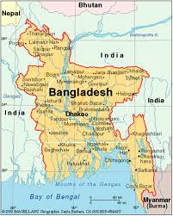
Population Patterns of Asia
Pakistan and Bangladesh
Became separate countries because of diverse ethnic differences
Bangladesh has 3,227 people per square mile
High population increases
Education increases lowers average birth rate

Slide 18
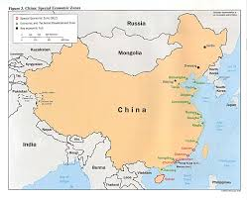
Population Patterns of Asia
China:
-1.4 billion people
-fertility rate 1.6 children/ woman
-World’s most populous country
-urbanization causes overcrowding in cities and not enough farm labor in rural areas
-one child per family policy

Slide 19
One Child Policy
Causes infanticide (killing babies)
Causes gender gaps
Highlights gender preferences (boys are preferred)

Slide 20
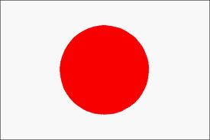
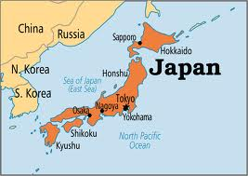
Population Patterns of Asia
Japan
128 million people → most live in urban areas along the coast
Tokyo is the worlds most populous city (35 million people)

