Slide 1
Geography of a Mango
By Alison Browne

Slide 2
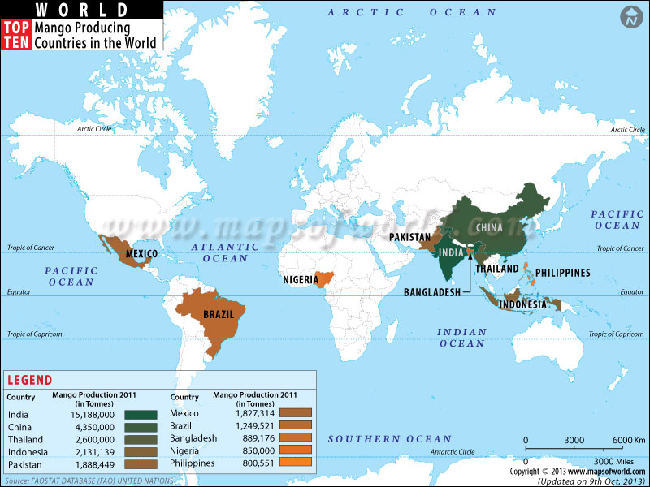
A. Mangos: Where and How are they Produced?
Mangos must be cultivated in a tropical climate near the equator. They cannot grow anywhere that has frost on the ground. Most mangos are produced in India, China, Mexico, Thailand, Indonesia, and Brazil. 80% of the mangos that are eaten in the USA are grown in Mexico. 50% of the world’s mangos are produced in India.

Slide 3
A. Mangos: Where and How are they Produced?
2. Mangos grow on trees and are usually farmed on large corporate orchards.
3. Mangos are typically grown in places that are free of fruit flies because they can destroy the mangos

Slide 4
B. Why are Mangos produced in Tropical Regions?
1. Mangos have been produced in India and South Asia for centuries because of the tropical climate and demand for it in that region.
2. The warm climate and frost free terrain allow mangos to grow in many regions of the world.
3. In India, most of the mangos are eaten in India so the exports are not very important to them. In Mexico, most of the mangos are exported to the USA, so it brings a lot of money to that country.
4. Most mangos are sold in supermarkets (in the developed world), fruit markets, or street stands.

Slide 5
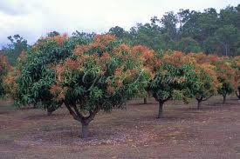
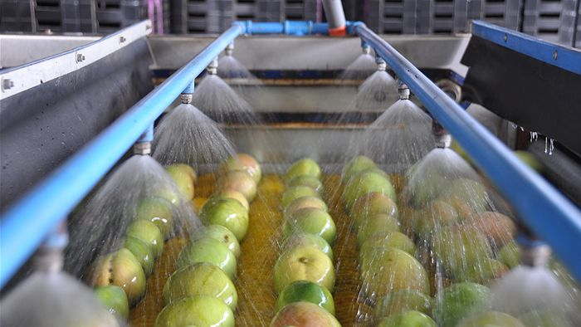
C. How and where is the item Processed?
1. Mango Orchard
Mango cleaning facility right before it goes onto a truck to its importing country

Slide 6
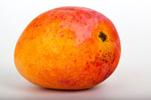
C. How and where is the item Processed?
2. VERY perishable, when they are green they are unripe, when they are red they are ripe. Mangos ripen at room temperature.
3. Most mangos are consumed in South Asia, specifically India. It is the national fruit of India, Pakistan, and the Philippines.

Slide 7
D. How is the item advertised?
1. Mangos are not heavily advertised and one example of a brand is Daniella.
2. Mangos are in very high demand and are not packaged for consumer targeting. They are just in a basket in a fruit section with a sticker on it.

Slide 8
E. Mapping the Journey of a Mango
Mango Orchard in Mexico
Cleaning facility at orchard
Transport to the USA
Local transport to supermarket
To consumers

Slide 9
F. Works Cited
"Selection, Ripening and Storage." Home. N.p., n.d. Web. 11 Aug. 2014.
"Fun Mango Facts for Kids - Interesting Information about Mangoes." Fun Mango Facts for Kids - Interesting Information about Mangoes. N.p., n.d. Web. 11 Aug. 2014.
"FreshFruitPortal.com » U.S. Mango Consumption Grows 117% in Four Years, Says NMB." Fresh Fruit Portal US Mango Consumption Grows 117 in Four Years Says NMB Comments. N.p., n.d. Web. 11 Aug. 2014.
"Mad About Mangoes: As Exports to the U.S. Resume, a Juicy Business Opportunity Ripens - Knowledge@Wharton." KnowledgeWharton Mad About Mangoes As Exports to the US Resume a Juicy Business Opportunity Ripens Comments. N.p., n.d. Web. 11 Aug. 2014.
"Growing Mangoes - How To Grow Mango Trees From Seed." Growing Mangoes - How To Grow Mango Trees From Seed. N.p., n.d. Web. 11 Aug. 2014.

