Slide 1
Checks and Balances
Ms. Browne
3/17/15

Slide 2
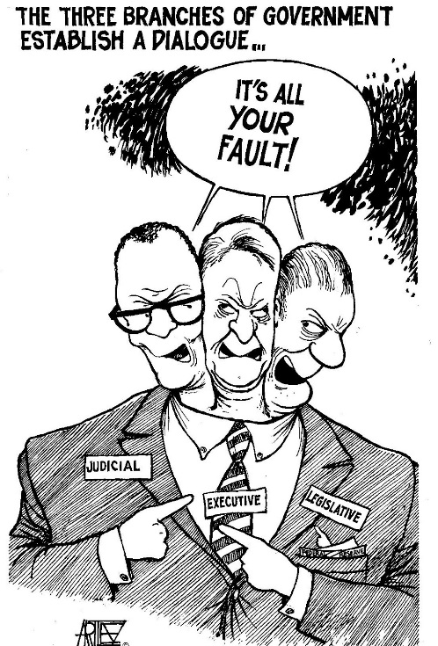
Bell Ringer
Use the picture to the right to silently answer the “do now” questions on your peach paper in complete sentences.

Slide 3
Objective
SWBAT describe the separation of powers and the checks and balances between the 3 branches.

Slide 4
Key Terms
Separation of Powers-
Division of government into three separate branches (legislative, executive, judicial)
2. Checks and Balances-
Each branch of government can limit the powers of the other two branches.

Slide 5
Think-Pair-Share – 1 minute
Why is it important to have checks and balances? What could happen if we didn’t have it?

Slide 6
Video Time- 3 minutes
https://www.youtube.com/watch?v=n_vADwxC58g

Slide 7
Video Guide – 2 minutes
With your partner, fill in the video guide using the information from the video and your knowledge of the United States Government.

Slide 8
Who’s Checking Whom??? 15 minutes
You will receive a folder of 6 documents. You and your partner’s job is to read through each document and fill in the chart on the back of your pink paper.

Slide 9
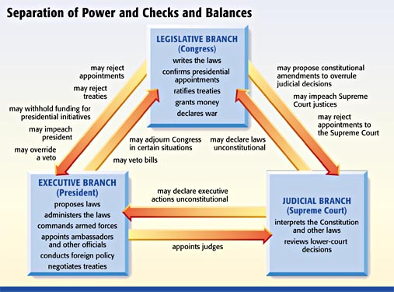
Checks and Balances

Slide 10
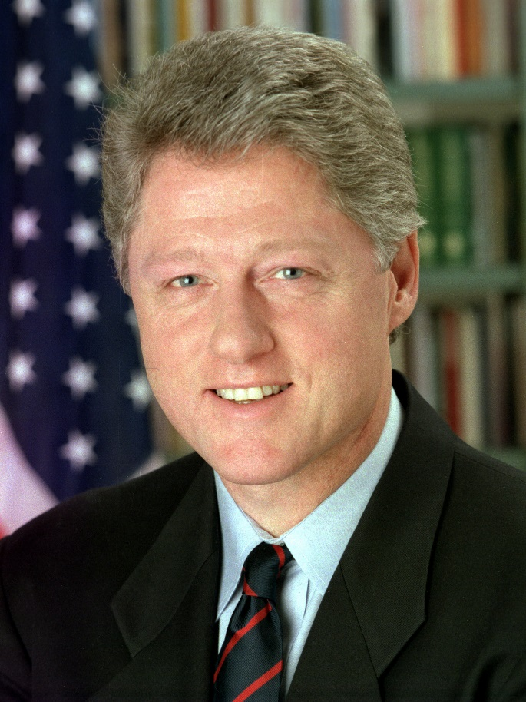
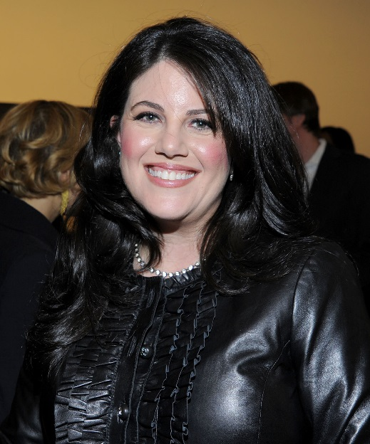
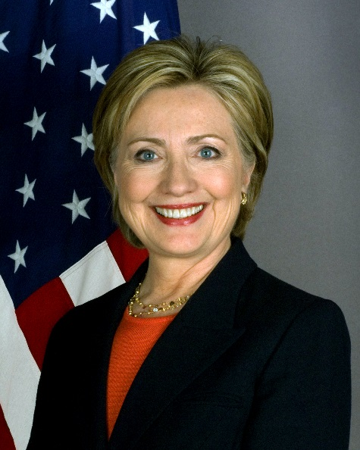
Clinton’s Impeachment
https://www.youtube.com/watch?v=2QTPVe6-Pso

Slide 11
Exit Slip
Silently answer the 4 multiple choice questions and flip it over when you’re finished.

