Slide 1
Climate and Population in Sub Saharan Africa

Slide 2
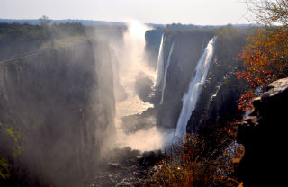
Bell Ringer
1. Turn to pg. 516 and look at the climate map of Sub Saharan Africa.
2. Fill out the 4 level map analysis on your paper

Slide 3
The Lion King- Video guide
https://www.youtube.com/watch?v=xB5ceAruYrI
Fill in your video guide as we watch the clip.

Slide 4
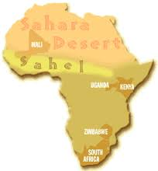
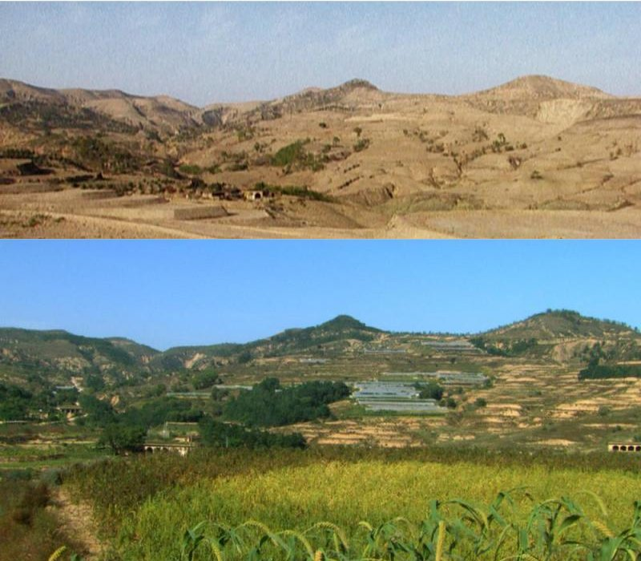
Desertification

Slide 5
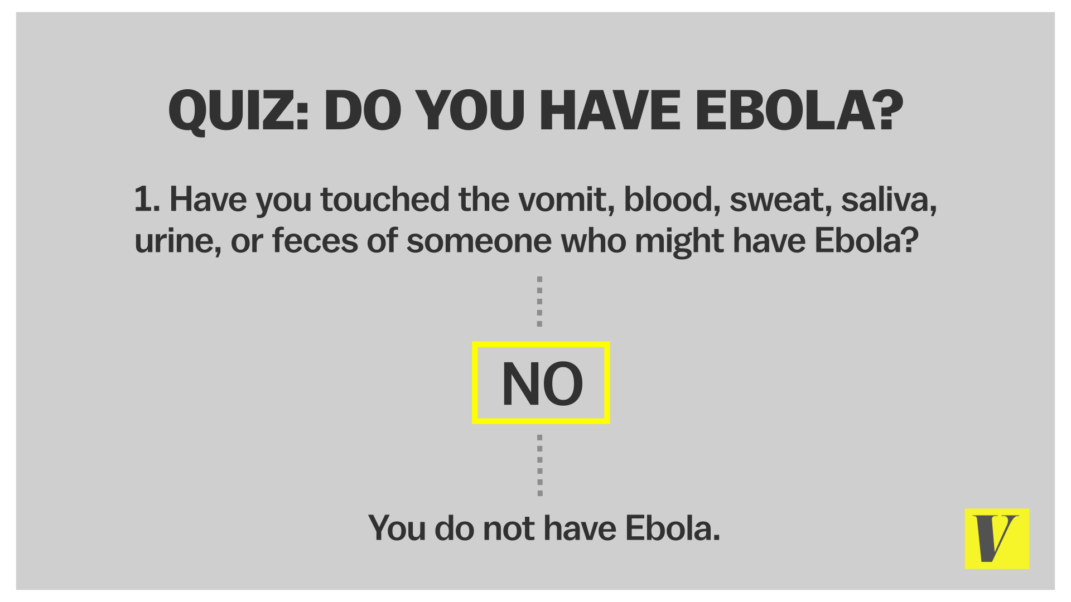

Slide 6
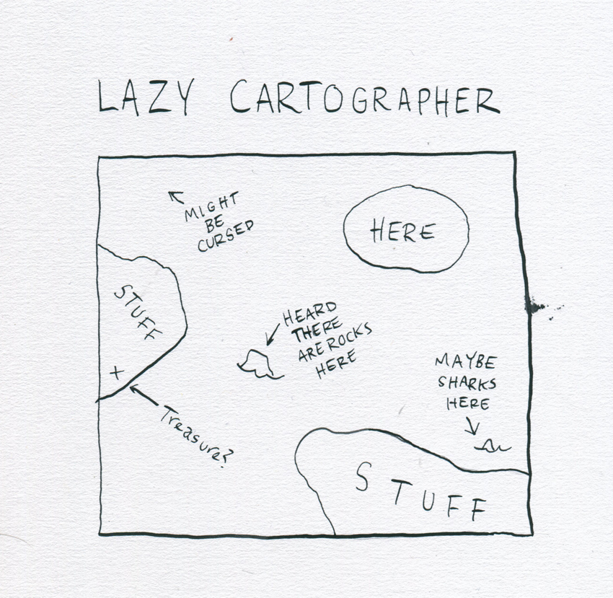
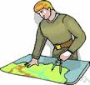
Map and Chart Analysis
Use the documents in your folder and
Answer the questions on the back of your pink sheet

Slide 7
EXIT TICKET
In 1 paragraph or less, describe what region of Sub Saharan Africa you think many people move away from? Why do they move away from there and where would they move to?

