Slide 1
Culture of Latin America
9/16/14
&
9/17/14

Slide 2
Bell Ringer
Without using a map, put the countries below into these categories: (on your paper from the orange bin)
Categories:
1. Central America/ Caribbean Islands
2. South America
3. Mexico
Countries:
Mexico, Haiti, Brazil, El Salvador, Argentina, Chile, Panama, Colombia

Slide 3
Vocabulary Practice
On your paper in the space provided do the following to your assigned word:
Describe
Give an example
Draw an image
Use in a sentence

Slide 5
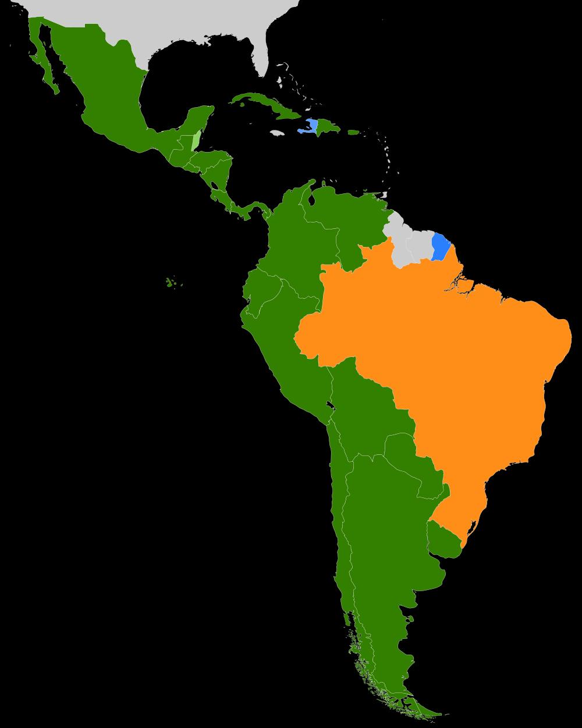
Mexico
Indigenous Groups: Maya in the Yucatan Peninsula
European Settlers + Maya = mestizo culture
https://www.youtube.com/watch?v=_x1WEYo4aWY
Mexico City- Largest city in Mexico
Indigenous religion + Catholicism = Syncretism
Malnutrition is a large problem in Mexico
Diego Rivera & Frieda Kahlo
Extended family is very important to culture

Slide 6
Caribbean/ Central America
Blends of different ethnic groups 2/3 Mestizos
Colombian Exchange
Spanish, French, Dutch (mainly Spanish)
75% Roman Catholic
Matriarchal- house is run by the women
Caribbean made up of Islands → many under foreign control

Slide 7
South America
350 different indigenous groups
Sao Paulo, Brazil & Buenos Aires, Argentina are 2 of the largest cities in the world
Spanish, Portuguese and Dutch are spoken
Most are Roman Catholic, but also many other religions
Soccer is very important to culture
Extended family is very important to many South Americans

Slide 8
1 sentence summaries
Write a 1 sentence summary of each of the 3 distinct culture regions within Latin America
Mexico
Caribbean Islands/ Central America
South America

Slide 9
Stations – 10 minutes for each
Vocabulary- Your group will get 3 sets of 3 vocab words. Your job is to write down how those words are related to each other
Mapping- choose one culture region of Latin America and decorate a map (with images and annotation) according to the culture of that region.
Language- shade in the different languages spoken in Latin America and write a 1 paragraph analysis of your findings

Slide 10
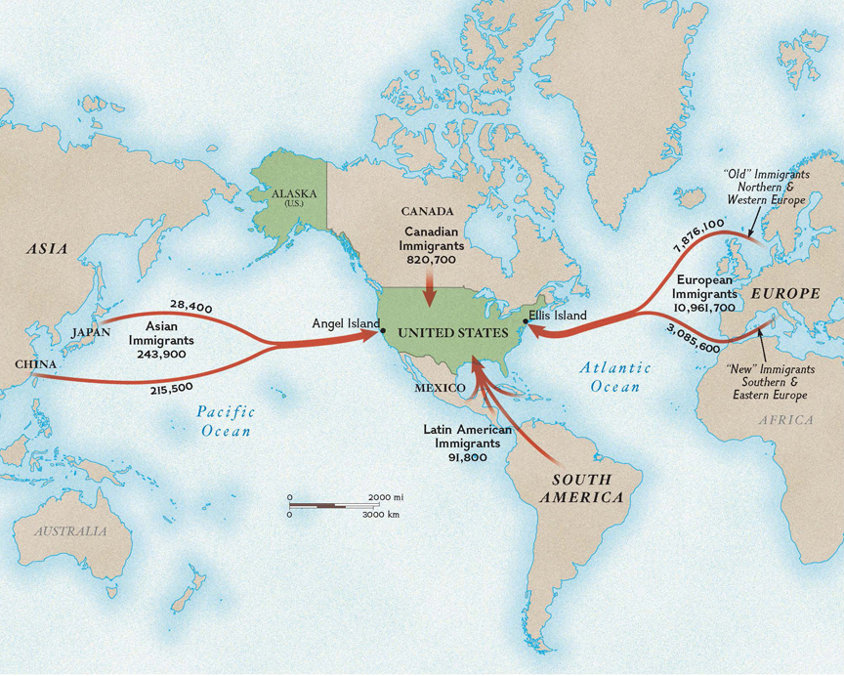

Slide 11
Exit Ticket
1. True or False: In South America there are not many indigenous groups

Slide 12
Exit Ticket
2. The main religion found in Latin America is:
Protestant
Muslim
Roman Catholic
Jewish

Slide 13
Exit Ticket
3. Mestizos ended up in Latin America because:
They are an indigenous group
European settlers mixed with the indigenous groups
They immigrated from Africa
Mestizos are not in Latin America

Slide 14
Exit Ticket
4. All of the following are countries in Latin America EXCEPT:
Spain
Argentina
The Bahamas
Cuba

Slide 15
Exit Ticket
What landform mainly makes up the region called the Caribbean
Mountains
Isthmuses
Peninsulas
Islands

