Slide 1
AP Human Geography
Class 7- Population

Slide 2
Bell Ringer
China only allows families to have one baby. Do you think this is acceptable? Vote yes or no.

Slide 3
Population growth is a HUGE problem worldwide, especially in LDCs (less developed countries). There are several theories and ideas about why this occurs and how to best fix it.

Slide 4
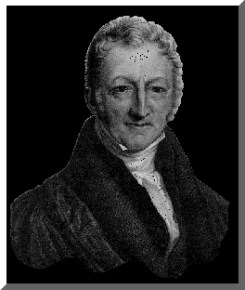
It all started with him
Thomas Malthus
British Economist
First critic to note that the world’s population was increasing faster than the supplies needed to sustain it

Slide 5
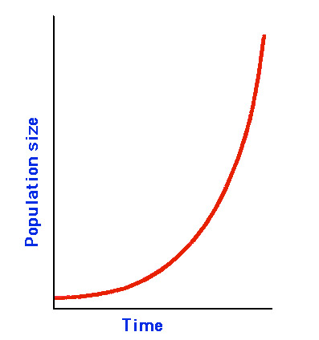
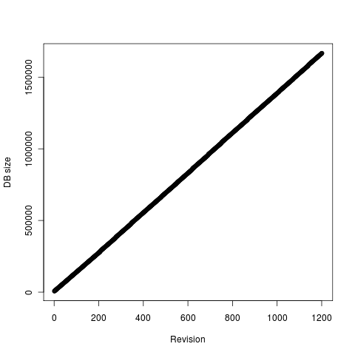
Malthus’ Beliefs
Population increased exponentially, or at a “geometric rate”
Food supplies grow linearly or at an “arithmetic rate”

Slide 6
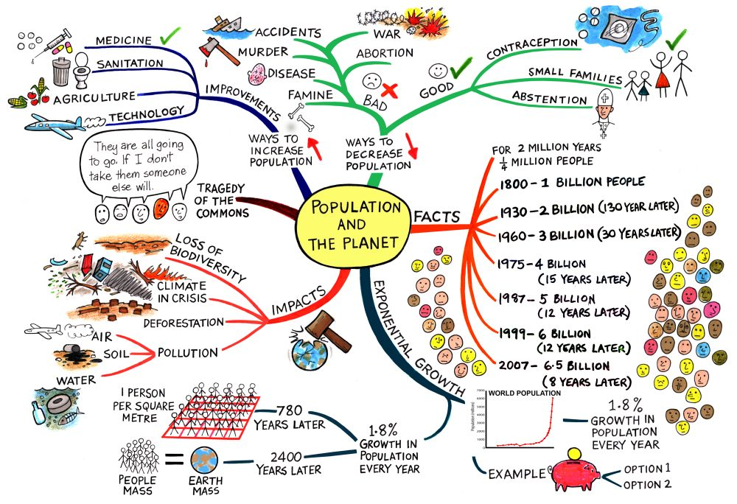
Neo-Malthusians
The Population Bomb, by Paul Ehrlich (1968)- popularizes neo-Malthusian ideas
Underpinnings for international programs for population limitation by birth control
Believe overpopulation will cause resource depletion or environmental degradation

Slide 7
The Demographic Transition Model
Process of change from:
High crude birth and death rates & low rate of natural increase
TO
Low crude birth and death rates & low rate of natural increase AND higher population

Slide 8
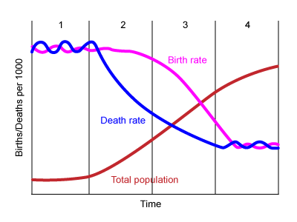
The 4 stages- every country is in one of these four stages.
Low Growth
High Growth
Decreasing Growth
Low Growth

Slide 9
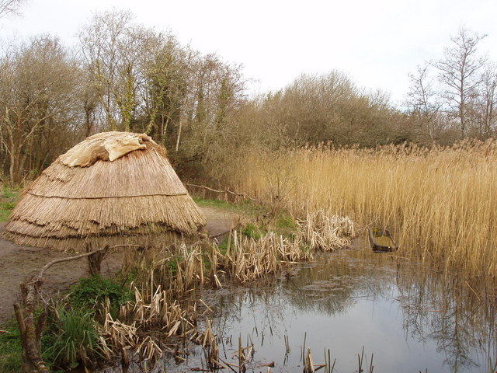
Stage 1- Low Growth
High birth rate and death rates produce virtually no long term natural increase
No country is in stage 1, these were the hunter gatherers

Slide 10
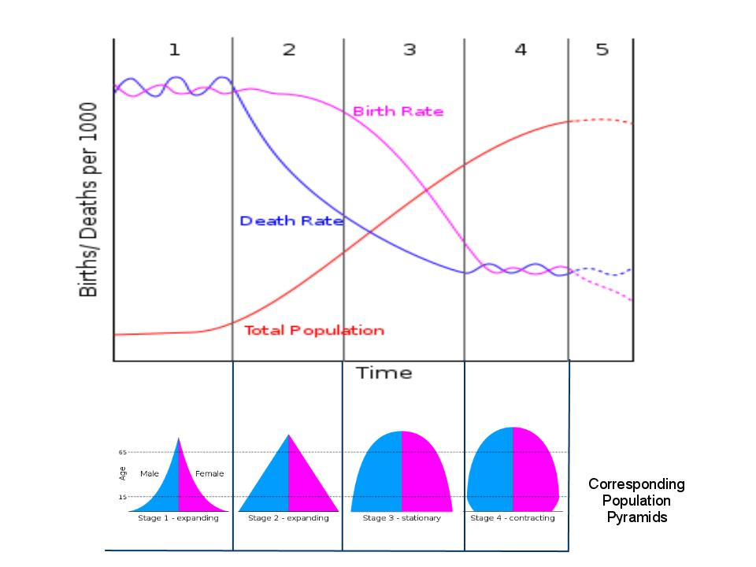
Stage 2- High Growth
Rapidly declining death rates and very high birth rates
Europe and North America were in stage 2 during the 1750s after the industrial revolution
Most of the developing world entered stage 2 during the 1950s
Medical revolution pushed many countries into stage 2
Most of the world’s poorest countries are in stage 2 with falling death rates but stable, high birth rates

Slide 11
Stage 3 Decreasing/ moderate growth
Birth rates decline, death rates decline
Mature industrial economy
Children become economic liabilities rather than assets because they live longer
Birth control is in effect
Children are living until adulthood and fertility rates fall

Slide 12
Stage 4- Low Growth
Very low birth rates and death rates produce virtually no long term natural increase and a possible decrease
ZPG (zero population growth)
Post industrial economy
Birth rates fall because women are working outside the home and children are more expensive
Women are more educated and delay marriage and children
Steady death rates
Population grows only very slowly or even decreases

