Slide 1
Federalism 3
3/30 & 3/31

Slide 2
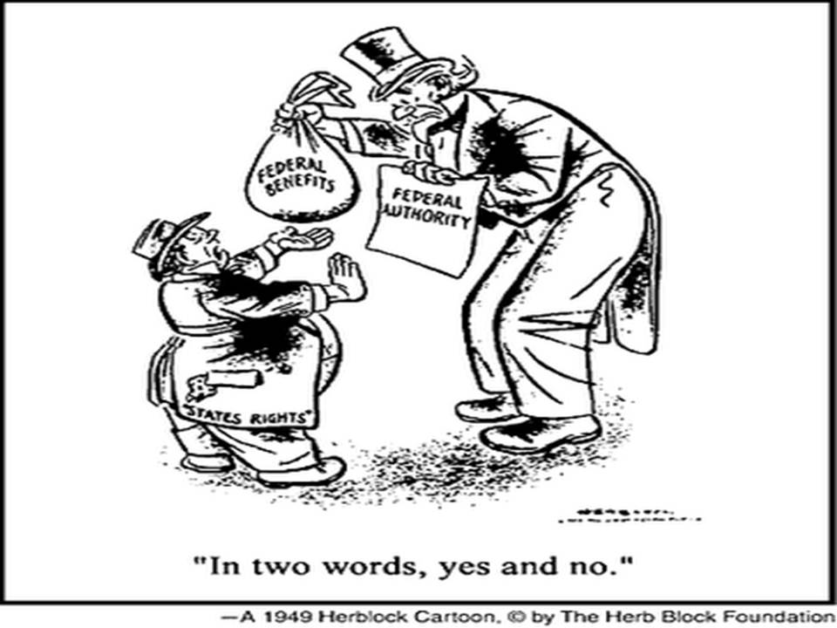

Slide 3
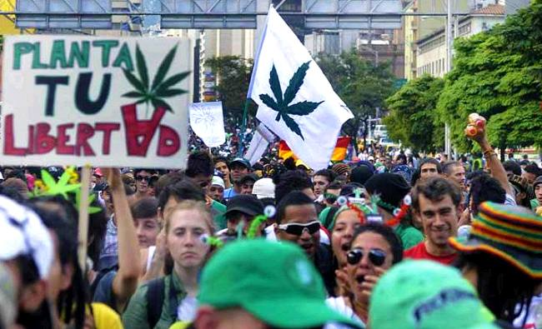

Slide 4
Pot Legal Dec. 6, ‘Jury is Out on What Happens ‘ After That
Jonathan Martin for the Seattle Times
Washington's grand social experiment with marijuana legalization begins Dec. 6 with a simple step: On that date, it is legal to have an ounce of the stuff, and there is little the federal government can do about it.
But how the state takes the next big step — transforming the marijuana black market into a closed, regulated and taxed marketplace — is unclear. And the federal government didn't help clarify its potential response on Wednesday.
The U.S. Department of Justice (DOJ) and U.S. Attorney Jenny Durkan, of Seattle, declined to answer questions about the conflict between the federal ban on marijuana and the new state law legalizing it for recreational use. A DOJ statement reminded voters that the federal ban "remains unchanged," and said the agency was reviewing the legalization measures, here and in Colorado.

Slide 5
Even as legalization proponents celebrated the historic confrontation with the federal drug policy, the state began the yearlong job of setting up a marijuana market. Which means within a month, you can possess marijuana and use it in private, but there's no place to legally buy it.
"The jury is out on what happens," said Gov. Chris Gregoire, referring to the federal response. "Meanwhile, my job as governor is to do what the people of the state of Washington have said they want done."
Bob Ferguson, the incoming state attorney general, said he could not predict the federal response. "I'm 100 percent looking forward to defending the will of the people and will defend it vigorously."

