Slide 1
Folk and Popular Culture
10/1/14

Slide 2
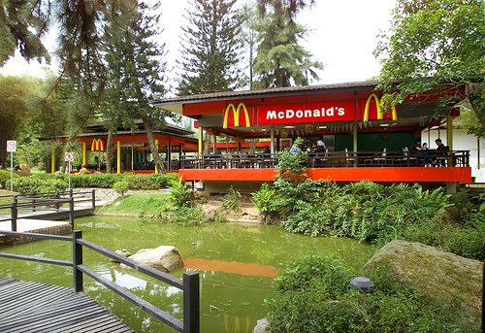
Bell Ringer

Slide 3
Vocabulary Matching Activity
Term, Description, Picture
Terms stand up, then descriptions, then picture

Slide 4
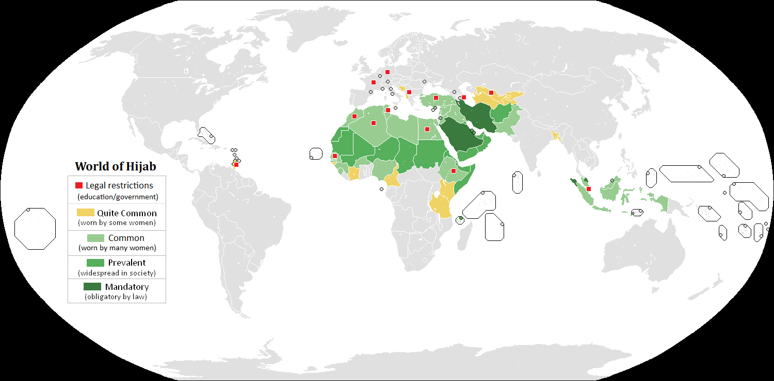
Countries where women wear Hijabs

Slide 5
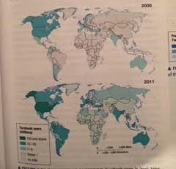
Worldwide Facebook Users

Slide 6
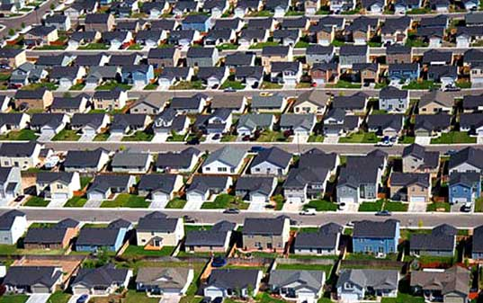
Placelessness
The loss of uniqueness in a place
Developed by geographer Edward Relph

Slide 7
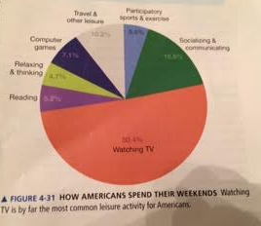
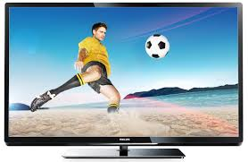
Diffusion of Popular Culture
Popular culture is spread electronically, mostly through TV

Slide 8
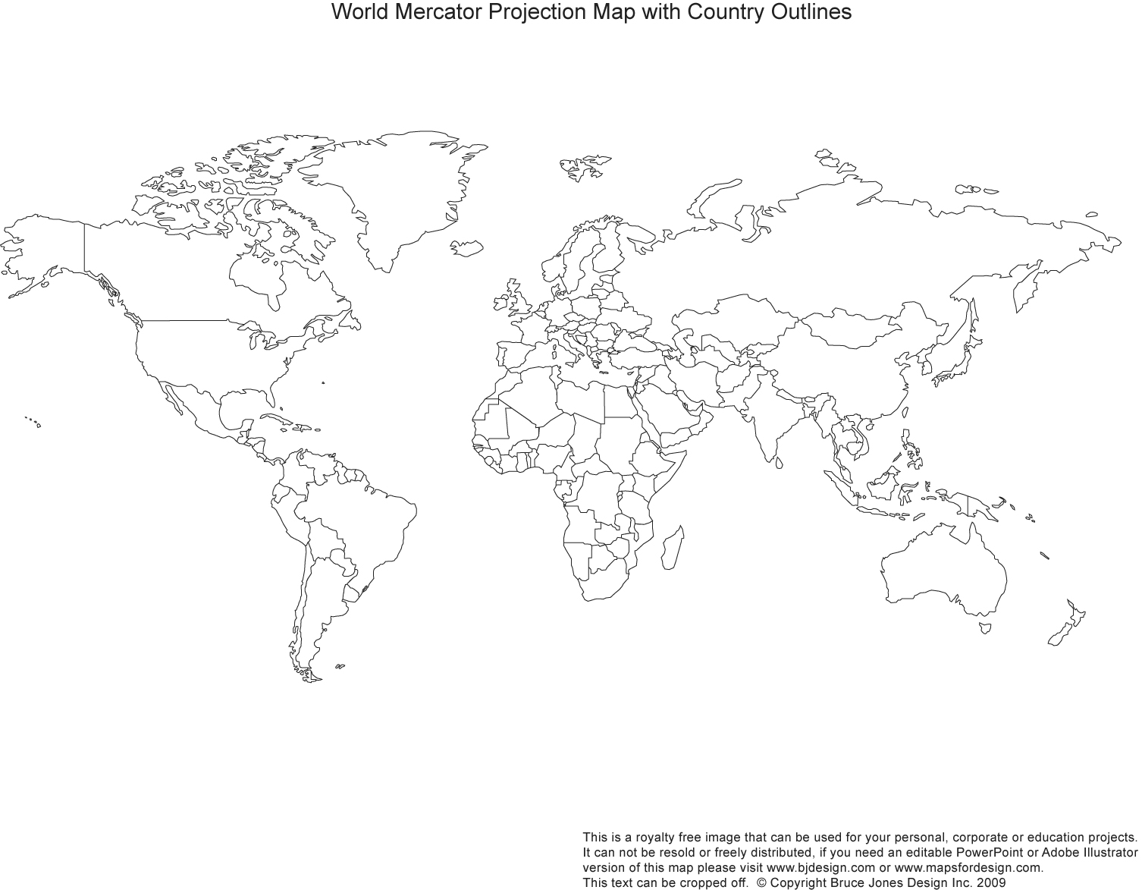
How did TV become so popular?
Early 20th Century- originates in the UK, France, Germany, Japan and Russia
Mid 20th Century-Diffuses to the United States, which had 86% of the world’s TV sets.
Late 20th Century-Diffusion throughout Europe
Early 21st Century- Universal access to television

Slide 9
TV continued
People around the world watch different programs and through different deliveries (on air, cable, satellite, Netflix etc) but watching TV is a huge popular culture leisure activity

Slide 10
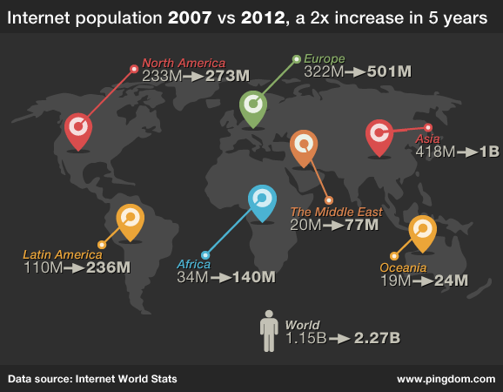
Diffusion of the Internet

Slide 11
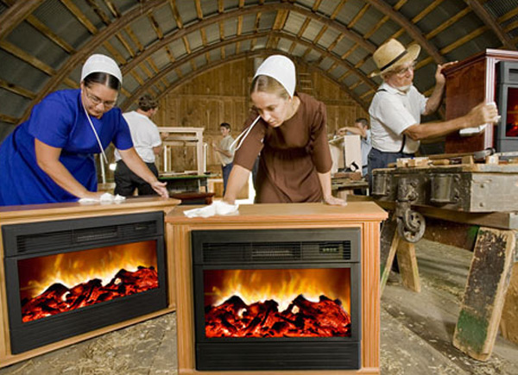
Effects on Folk Culture
External Threat- most content diffused through electronic media originates in a few developed countries
Internal Threat- Latest forms of social media enable people in developing countries to originate the content themselves.
Folk Culture followers enjoy many aspects of popular culture, however they fear that it will threaten the future of their culture. They do not want the folk culture to assimilate into the popular culture.

Slide 12
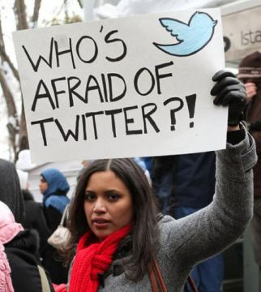
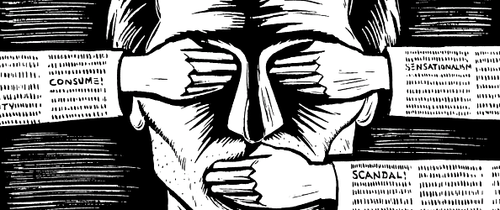
Fighting Threats to Folk Culture
Censorship
Limiting internet access
Banning certain TV channels or movies

Slide 13
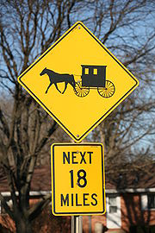
Preserving Folk Culture
Dangerous or Beneficial?

Slide 14
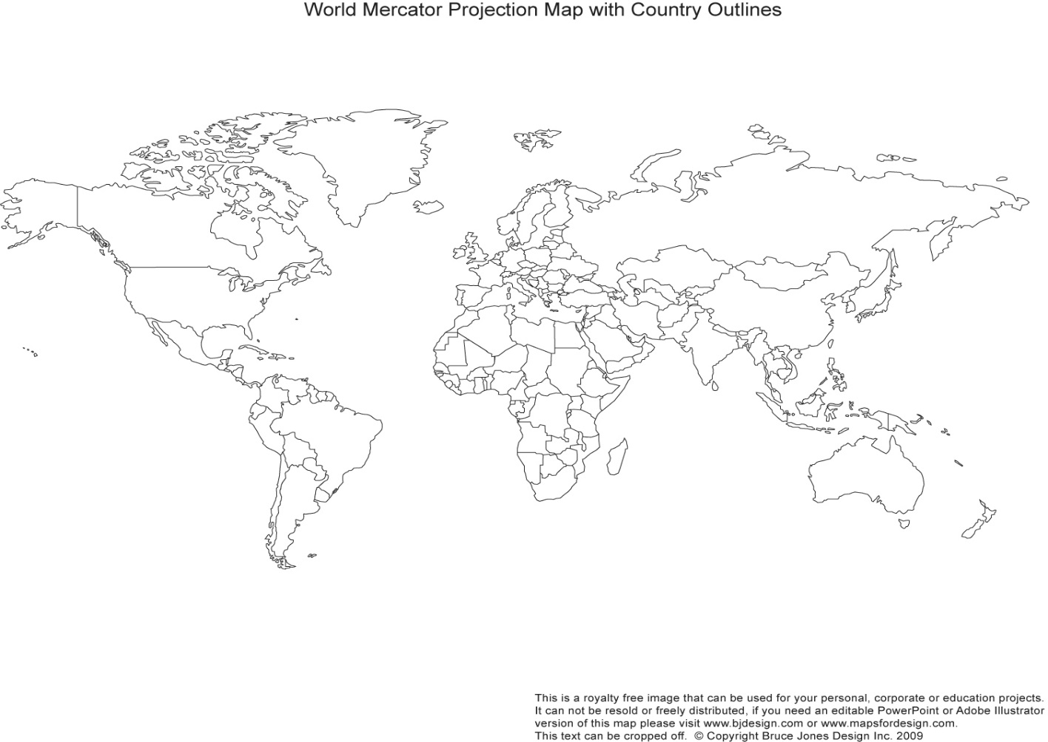
Censorship Examples: Looking at China, Iran, and North Korea
https://www.youtube.com/watch?v=b7J2wD-eLQk

Slide 15
What do you think?
Tell your neighbor your opinion on censorship around the world.

Slide 16
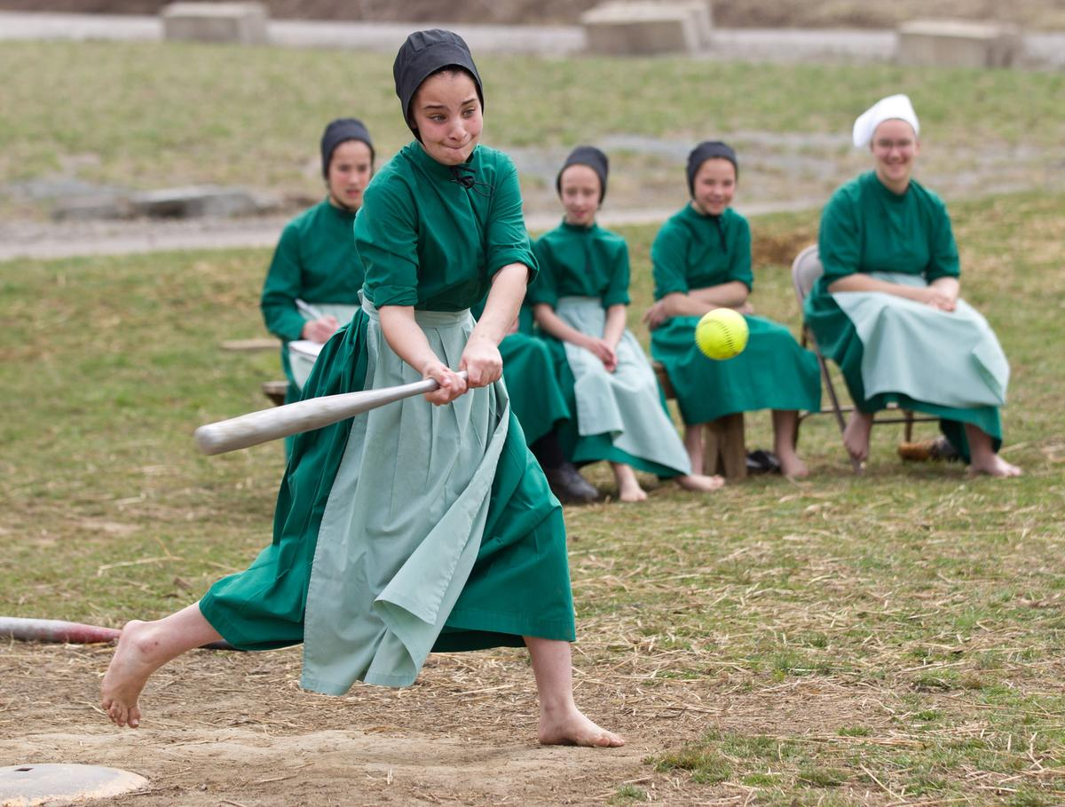
Amish Article
Annotate the article by doing the following:
Write the main idea of each section
Circle evidence of preserving folk culture
box threats to folk culture
Underline special treatment the Amish receive from the government.
2. Complete the Article Review Form

Slide 17
Exit Ticket-Answer the following questions in 1 paragraph.
Is it important to preserve folk culture? To what extent should governments and people try to preserve it?

