Slide 1
CLASS #4
Geospatial themes and The Gravity Model

Slide 2
Bell Ringer
Add the following vocab terms to your vocab section:
Abet (v)- To help someone do something bad.
Distance (n)- Measurement of physical space between two places.

Slide 4
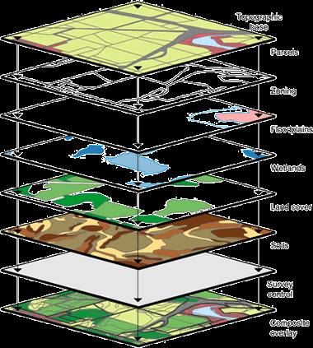
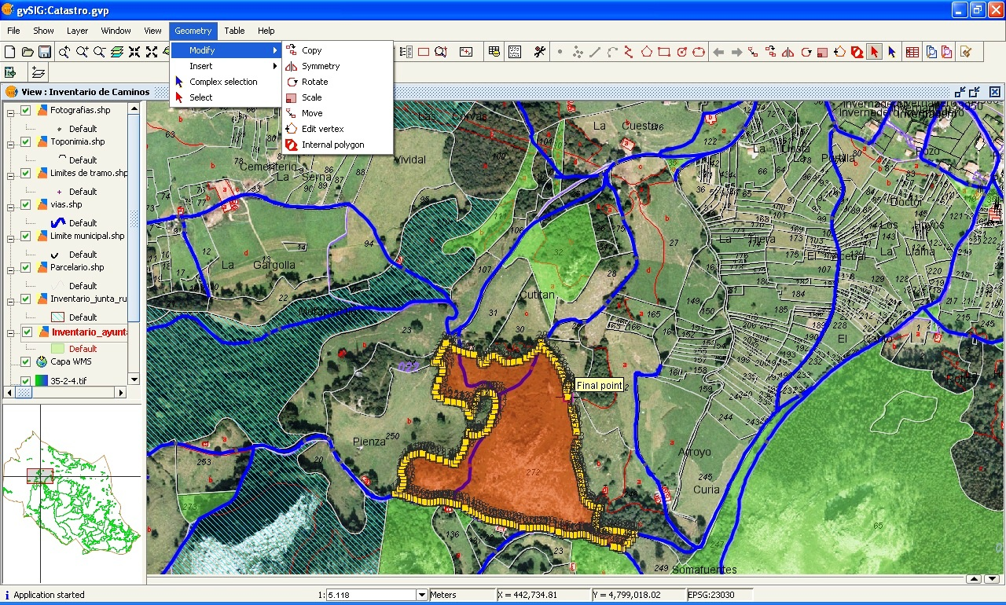
GIS and GPS
Tools geographers use to get information about the world

Slide 5
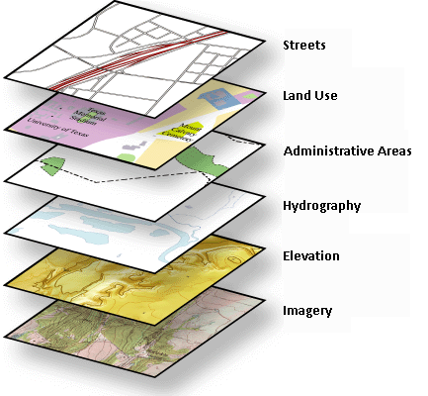
GIS- Geographic Information System
A computerized system that captures, stores, analyzes, and displays geographic data. It can be used to produce maps. Information can be produced in layers and those layers can be compared to show relationships among different kinds of information.

Slide 6
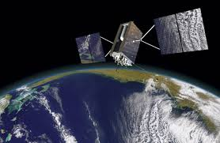
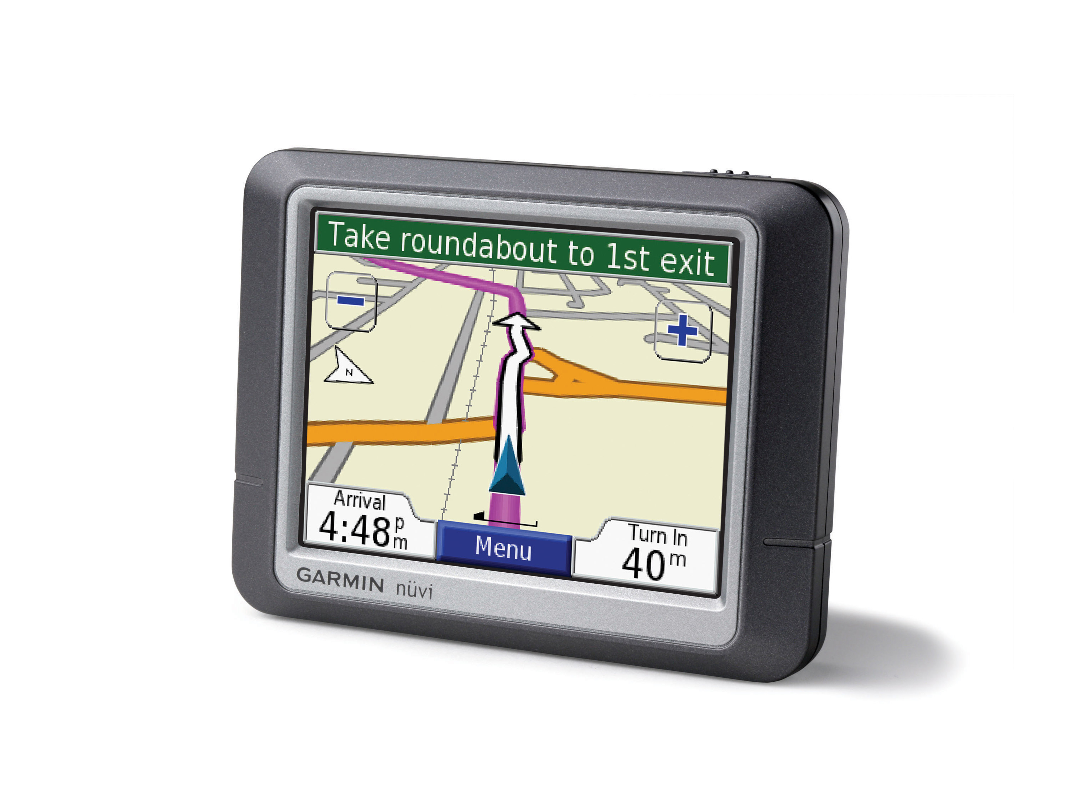
GPS- Global Positioning System
Mostly used for navigation but can also be used to find a precise location.
-Satellites placed in space
-Tracking stations exist to monitor and control satellites
-A receiver that can locate satellites

Slide 7
The Gravity Model

Slide 8
The Gravity Model

Slide 9
Gravity Model Example

