Slide 1
Language
AP Human Geography 10/30

Slide 2
Vocab Bell Ringer
Define and use in a sentence.
SAT Word: placate
AP Word: language convergence

Slide 3
Language Quiz – 10 minutes
Clear your desks and take out a writing utensil.

Slide 4
Review
Language Family
↓
Language Branch
↓
Language Group
↓
Language

Slide 5
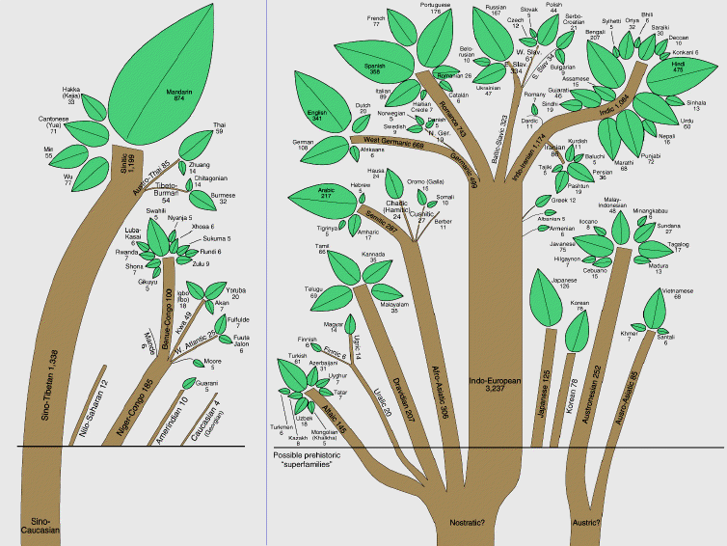

Slide 6
Example: English
Family:
Branch:
Group:
Language:

Slide 7
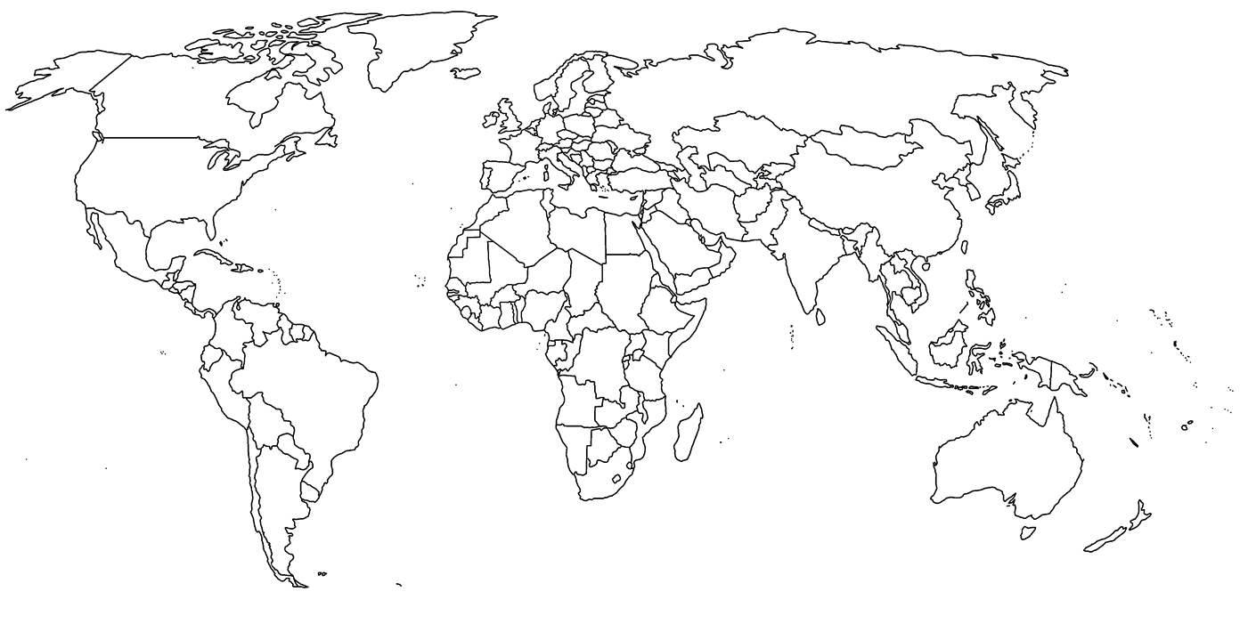
Global Language Families
Create a choropleth world map of the distribution of major language families. Make sure to include a color coded key.

Slide 8
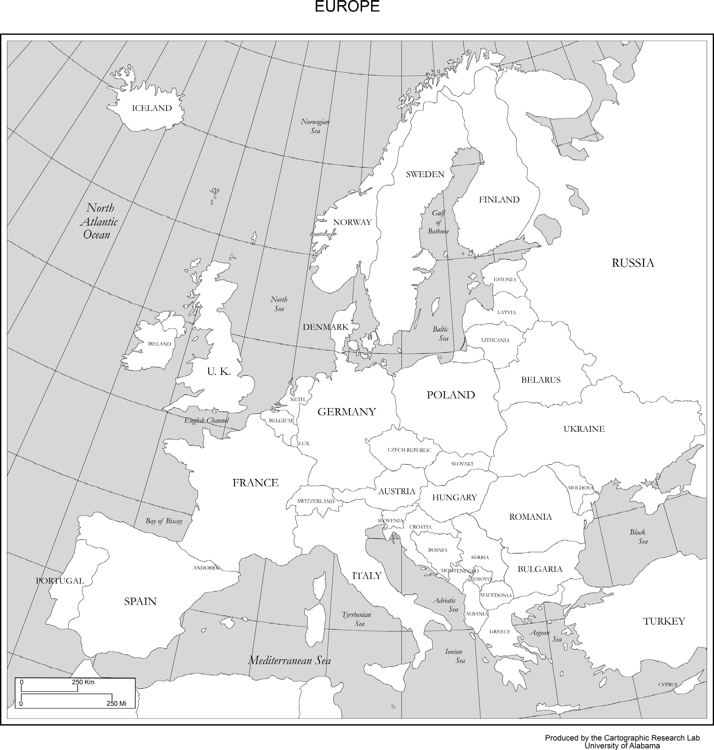
Indo European Branches
Make a choropleth map of the Indo European language branches in Europe. Include a color coded key.

Slide 9
Origin and Diffusion of English
British Isles- first known language is Celtic around 2000bc
German invasion- Angles, Jutes, Saxons
Modern English evolved from these Germanic groups
Viking invasion- failed to conquer British Isles, but many Vikings remained and added vocabulary to the newly spoken English language.

Slide 10
Origin and Diffusion of English
Norman Invasion- 1066 British isles invaded by Normans
Normans came from Normandy, France and established French as England’s official language for 300 years.
Many still spoke English to each other

Slide 11
Origin and Diffusion of English
German Invaders- simple straightforward words “horse, sky, man”
Norman Invaders- fancier words “celestial, equestrian, masculine”

Slide 12
Diffusion to North America
English Colonies
Jamestown, Virginia, 1607
Plymouth, Massachusetts, 1620
British defeat of France to dominate the colonies established English as the principal language

Slide 13
Document Based Questions
Use the documents to answer the questions on your sheet

Slide 14
Closing Question
In 1 paragraph, explain how languages create a cultural unity and diversity throughout the world.

