Slide 1
Language
11/5/14

Slide 2
Bell Ringer – 11/5/14
Define (in your own words) and draw an image for each of the following words:
Isogloss
Creole or creolized language
Dialect
Accent
Standard language

Slide 3
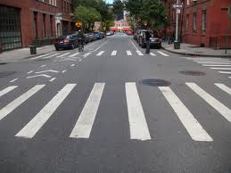
Crosswalk or Zebra crossing?

Slide 4
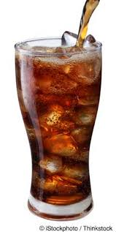
Soda, Coke, or Pop?

Slide 5
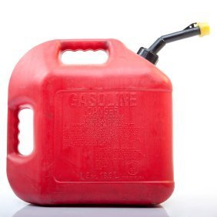
Petrol or Gas?

Slide 6
Y’all, Yous or You Guys?

Slide 7
Stations – 15 minutes each
1- Fill in the rest of the chart (crash course chapter 8)
2- Make at least 5 flash cards of language terms (using descriptions and/or pictures)
3- Create a pyramid game (using any terms we’ve learned) and play with a partner (continue making games until time is up)
4- Practice CRQ

