Slide 1
Monotheism
10/20/14
10/21/14

Slide 2
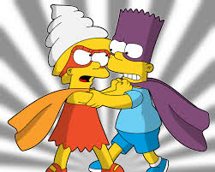
Bell Ringer
Respond to the following scenario in 4-6 sentences.
What would you do if one family member came into your room and said “this is my room now. Pack up your stuff and be out of here within the next two hours.” Would you leave? Would you stay? How would you resolve this conflict?

Slide 3
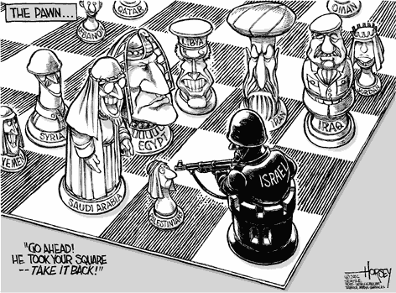
Arab-Israeli Conflict

Slide 4
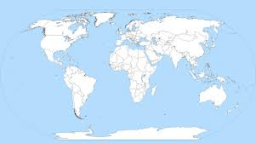
Where is the Arab (Palestinian) and Israeli Conflict

Slide 5
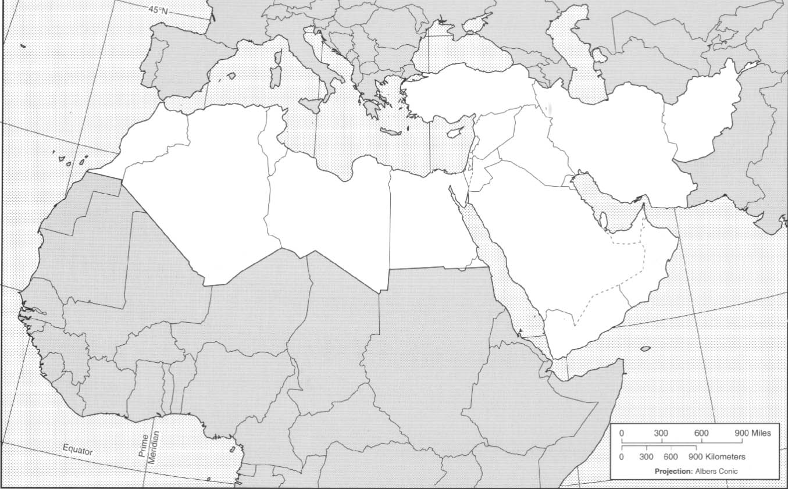
Where is the Arab (Palestinian) Israeli Conflict?

Slide 6
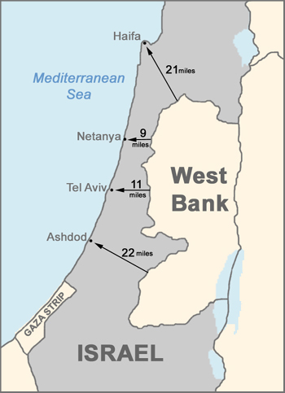
Where is the Arab (Palestinian) Israeli Conflict?

Slide 7
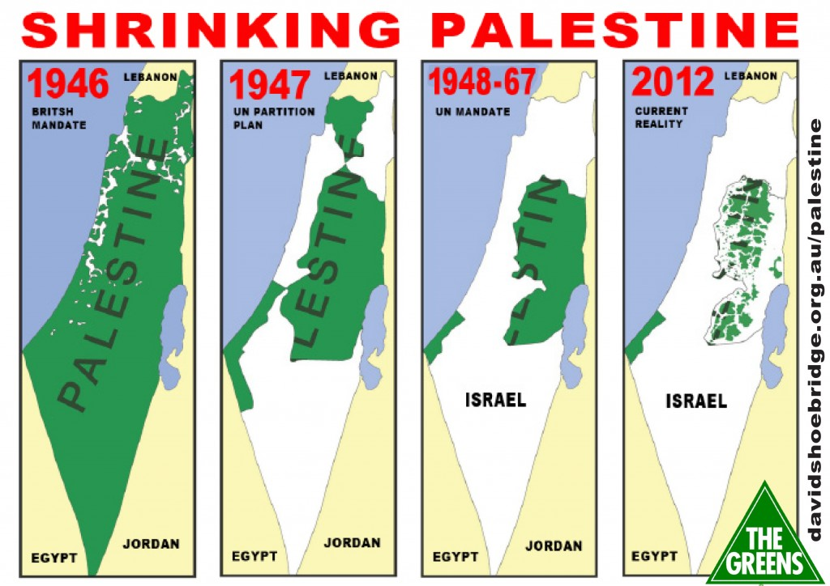
Arab/Israeli territory

Slide 8
Monotheistic Religions Video
https://www.youtube.com/watch?v=nqeUhsQmr-g
Fill out your video guides while we watch the videos

Slide 9
Task 1: 20 minutes
Read the information on Christianity, Judaism and Islam and fill out your chart

Slide 10
Task 2 (20 minutes)
Use the choice board to the right to pick a way to present the following information:
On[e monotheistic religion (Christianity, Islam, or Judaism)
Beliefs
Founder
Origin
Symbols
6. Presence/ Importance in the Middle East
7. Holy Book/ Place of worship
8. Information about one major holiday
Powerpoint | Poster | Song
Essay | CHOOSE ONE | Foldable
Brochure | Booklet | Make a game

Slide 11
Performance task: Choose one item from each column to complete a project Outside research is encouraged, and sources must be cited. Standard: SSWG3 Students will explain the interaction of physical and human geography in North Africa/ Southwest Asia
COLUMN A: TOPICS | COLUMN B: PROJECT TYPES
Islam, Judaism, and Christianity The Sahara Desert Ethnic groups in the Middle East (Arabs, Israelis, Kurds, Persians) OPEC & Oil in the Middle East Desalination Malala Terrorist Groups The Atlas Mountains The Nile River | Brochure Poster Foldable Song Essay/ news article Powerpoint Board game/matching game Booklet
Checklist:
Title – 5 points
Content: 10 facts or sources of relevant and correct information-20 points
Visually pleasing and at least 2-3 images, charts, graphs, or pictures- 10 points
Organization- clear headings or sections – 10 points
Name and Date- 5 points
_____/50

Slide 12
Exit Ticket
Answer your multiple choice questions on the clickers

