Slide 1
Visual Vocabulary

Slide 2
Latin America Quiz
10 multiple choice questions – 10 minutes

Slide 3
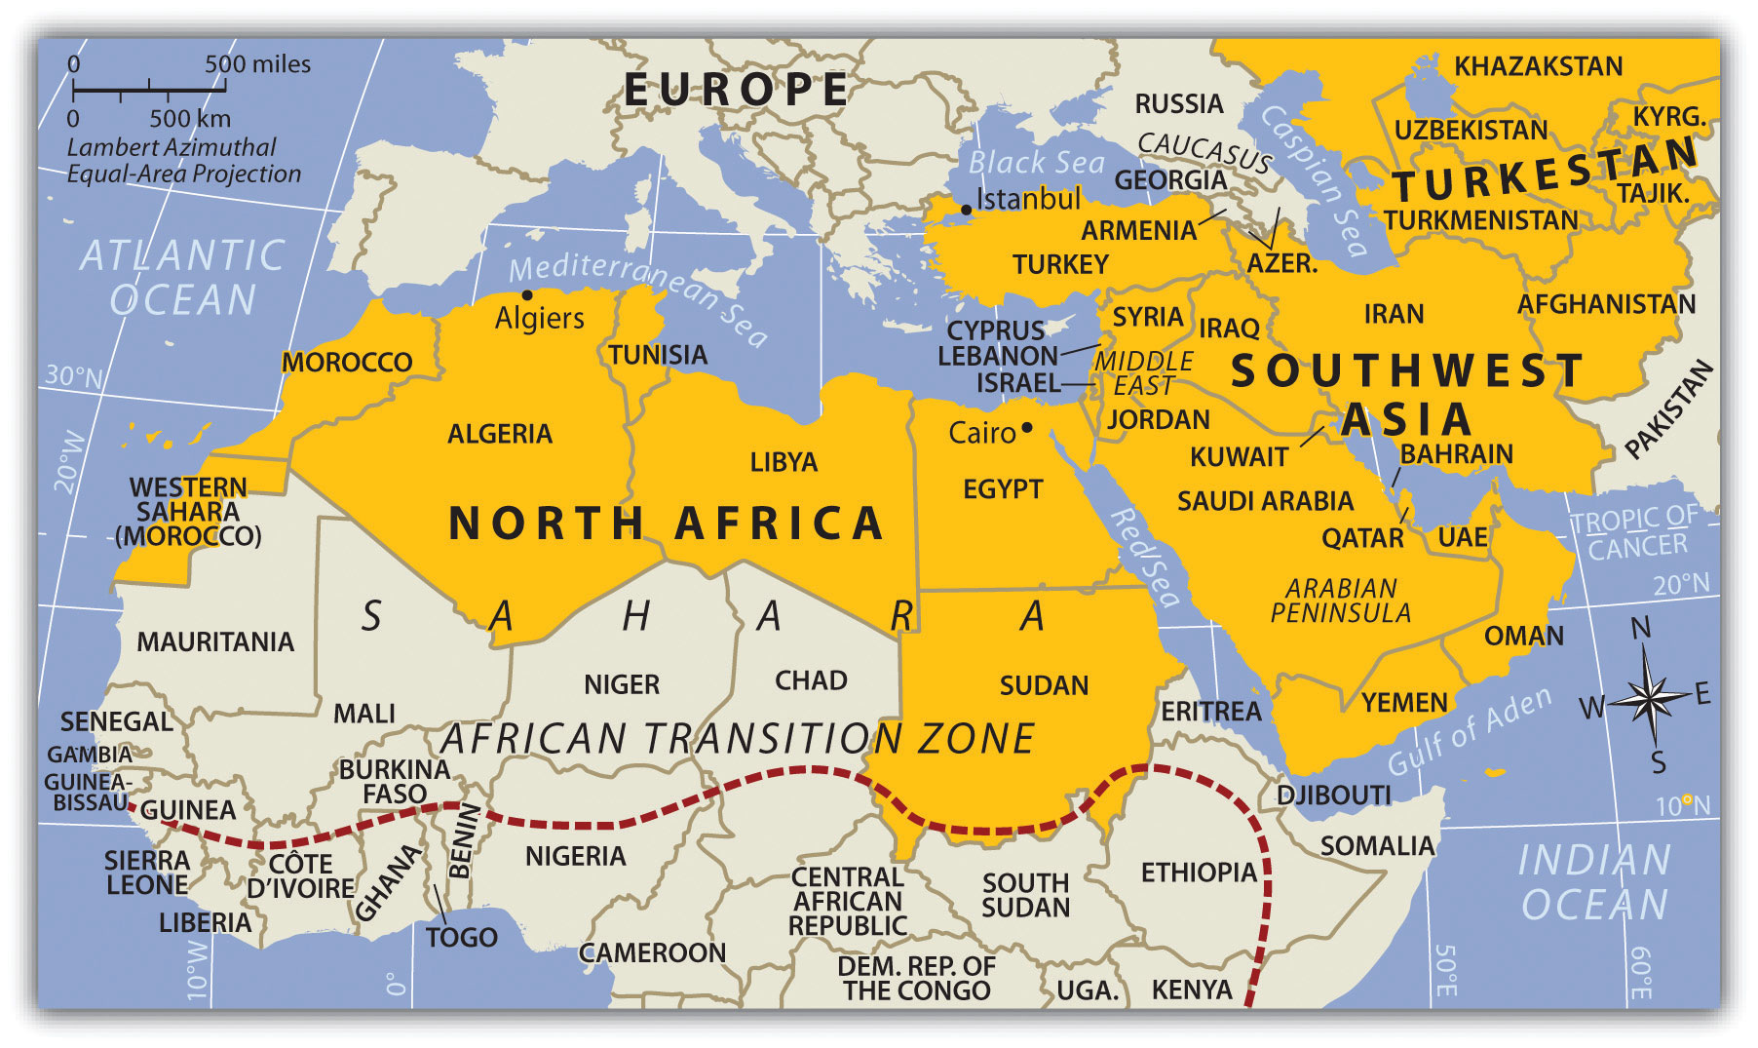
North Africa and Southwest Asia

Slide 4
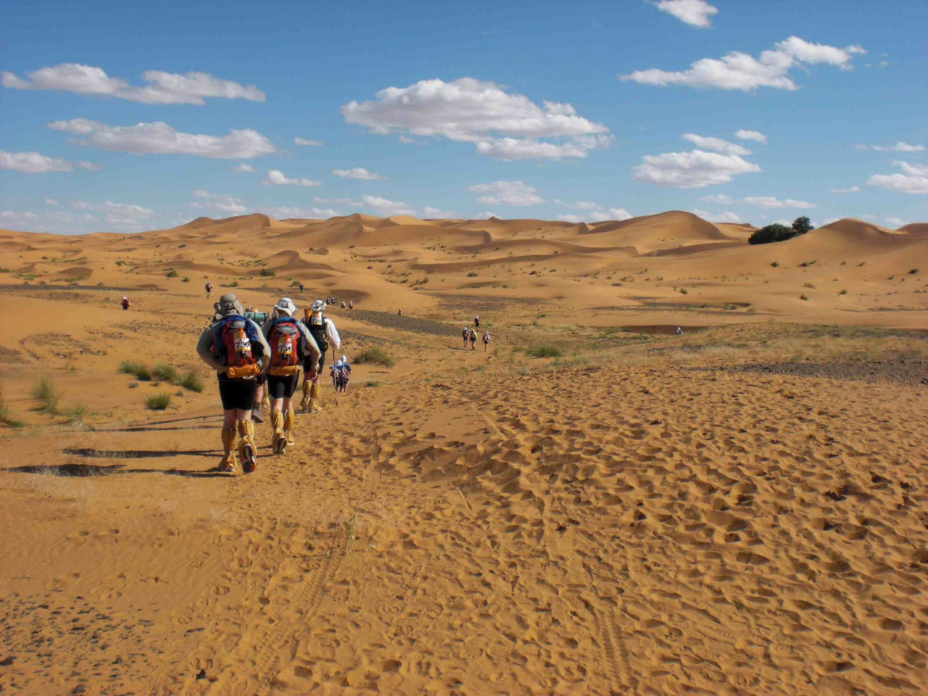
The Region
Most of the region is deserts and mountains

Slide 5
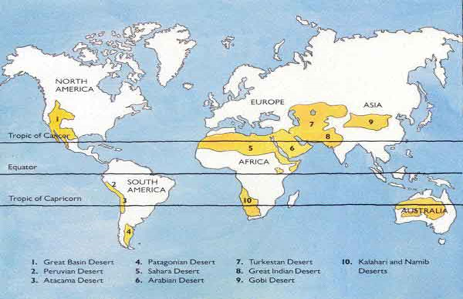
4 Level Map Analysis

Slide 6
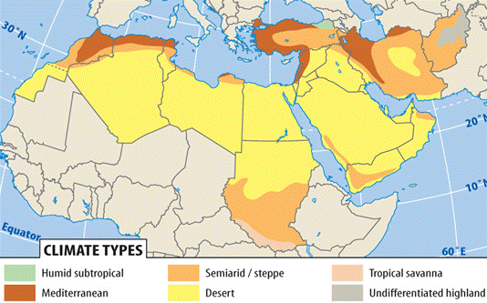
Climate Map

Slide 7
Partner Vocabulary Matching- 10 minutes
Match the TERM with the PICTURE and DESCRIPTION by putting them in a pile

Slide 8
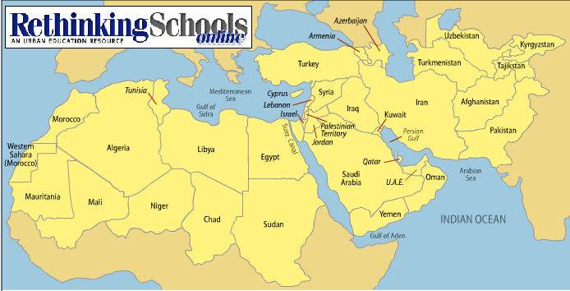
Map Work Part 1 (7 mins)
Label the important Middle Eastern countries on your map

Slide 9
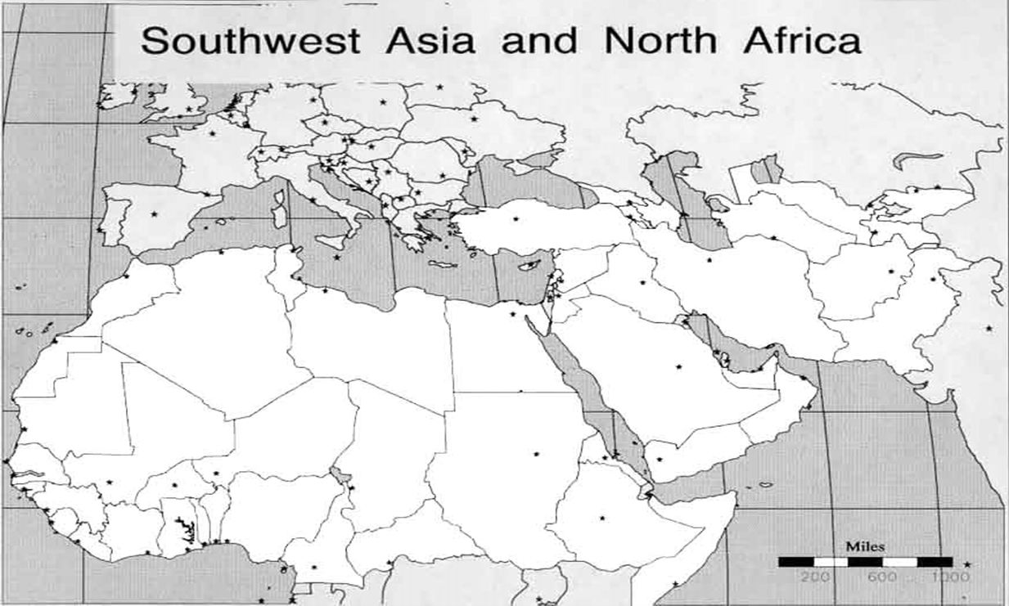
Map Work Part 2 (15 mins)
Label and write the impact of each term in your vocabulary piles on your map. Then put the cutout squares back in the plastic bags

Slide 10
Exit Ticket
Independently complete the 4 test prep questions on your half sheet of paper.
Turn it over and sit silently when you are done.

Slide 11
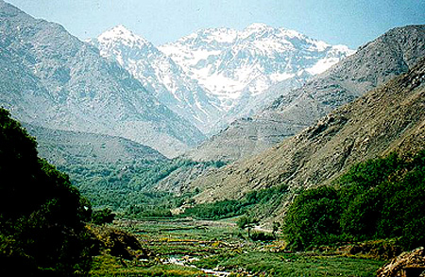
Atlas Mountains
Africa’s longest mountain range stretching from Morocco to Algeria
Rain on northern side makes it a rare fertile area in this region

Slide 12
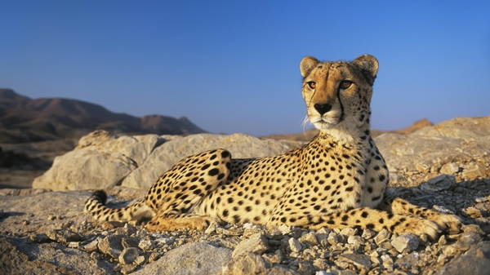
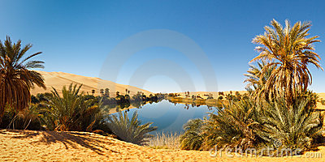
Sahara Desert
Largest Desert in the world
Only 25% sand
Holds human, animal, and plant life

Slide 13
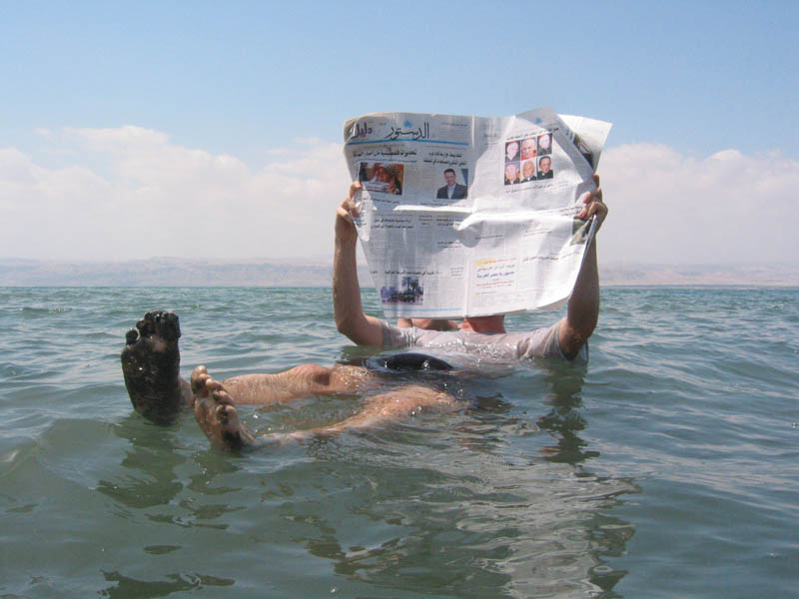
Dead Sea
Lowest elevation in the world
So salty that nothing can live in it

Slide 14
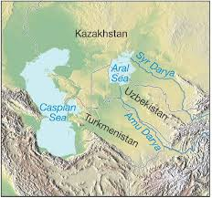
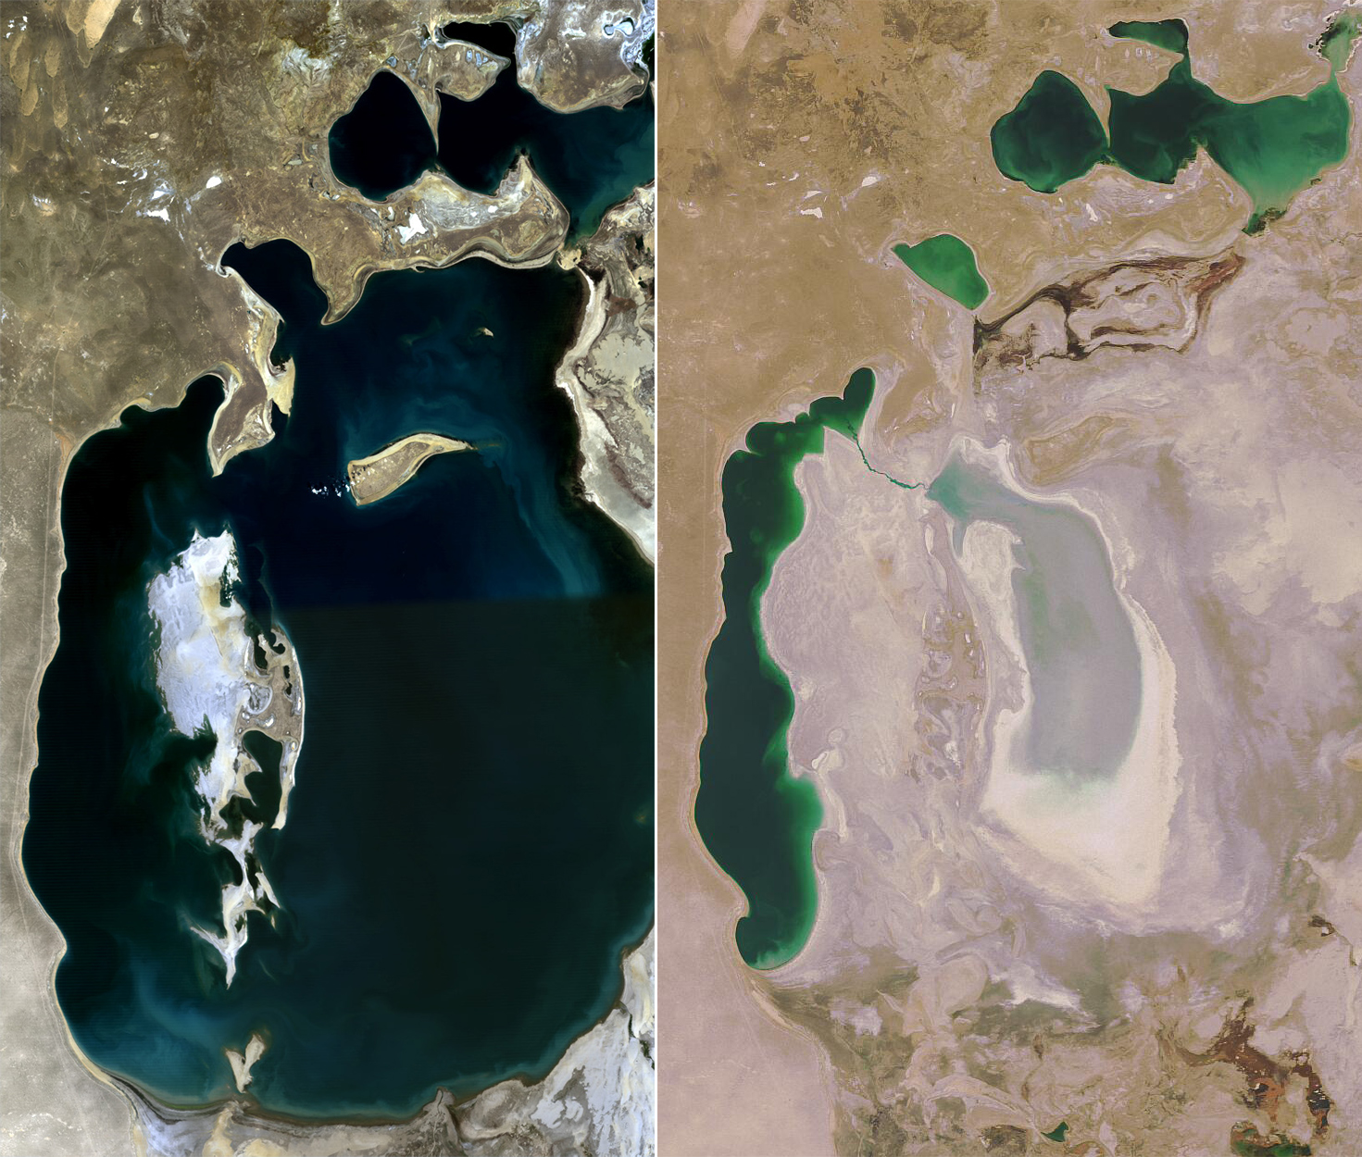
Aral Sea
Small inland sea that is shrinking because of Russian Irrigation

Slide 15
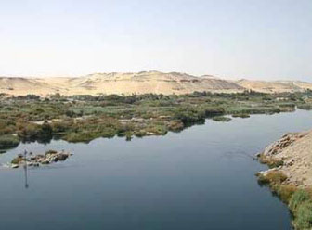
Nile River
Largest river in the world
Provides an oasis of fertile soil to the Sahara Desert

Slide 16
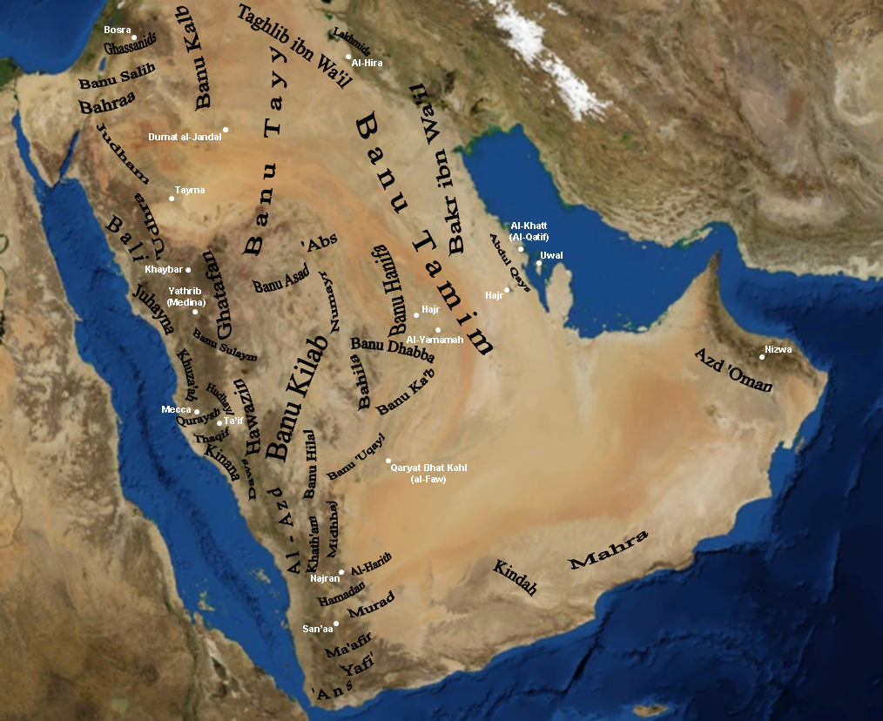
Arabian Peninsula
Peninsula made up of many countries
Sits in between Africa and Asia

Slide 17
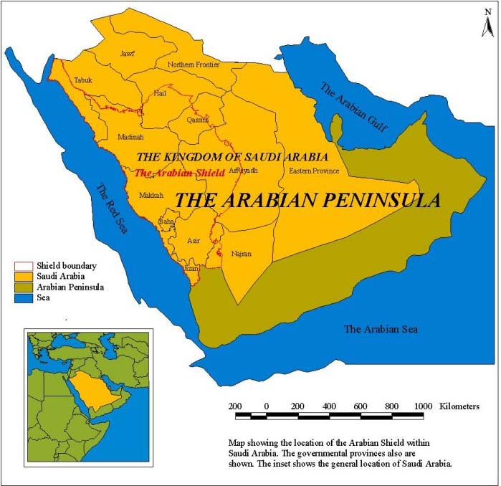
Plains, Seas, and Peninsulas
Agriculture mainly on fertile plains off of the:
Mediterranean Sea
Caspian Sea
Persian Gulf
Puzzle of Seas and Peninsulas
Arabian Peninsula
Persian Gulf
Sinai Peninsula
Dead Sea
Caspian Sea
Aral Sea

Slide 18
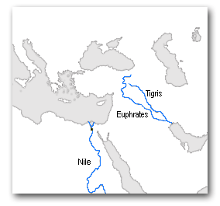
Famous Rivers
Nile- longest river (4160 miles)
Held world’s earliest civilization
Aswan High Dam → agriculture and hydroelectric power
Tigris River
Euphrates River
Tigris & Euphrates
support Farming

