Slide 1
Protests and Civil Unrest
4/3/15

Slide 2
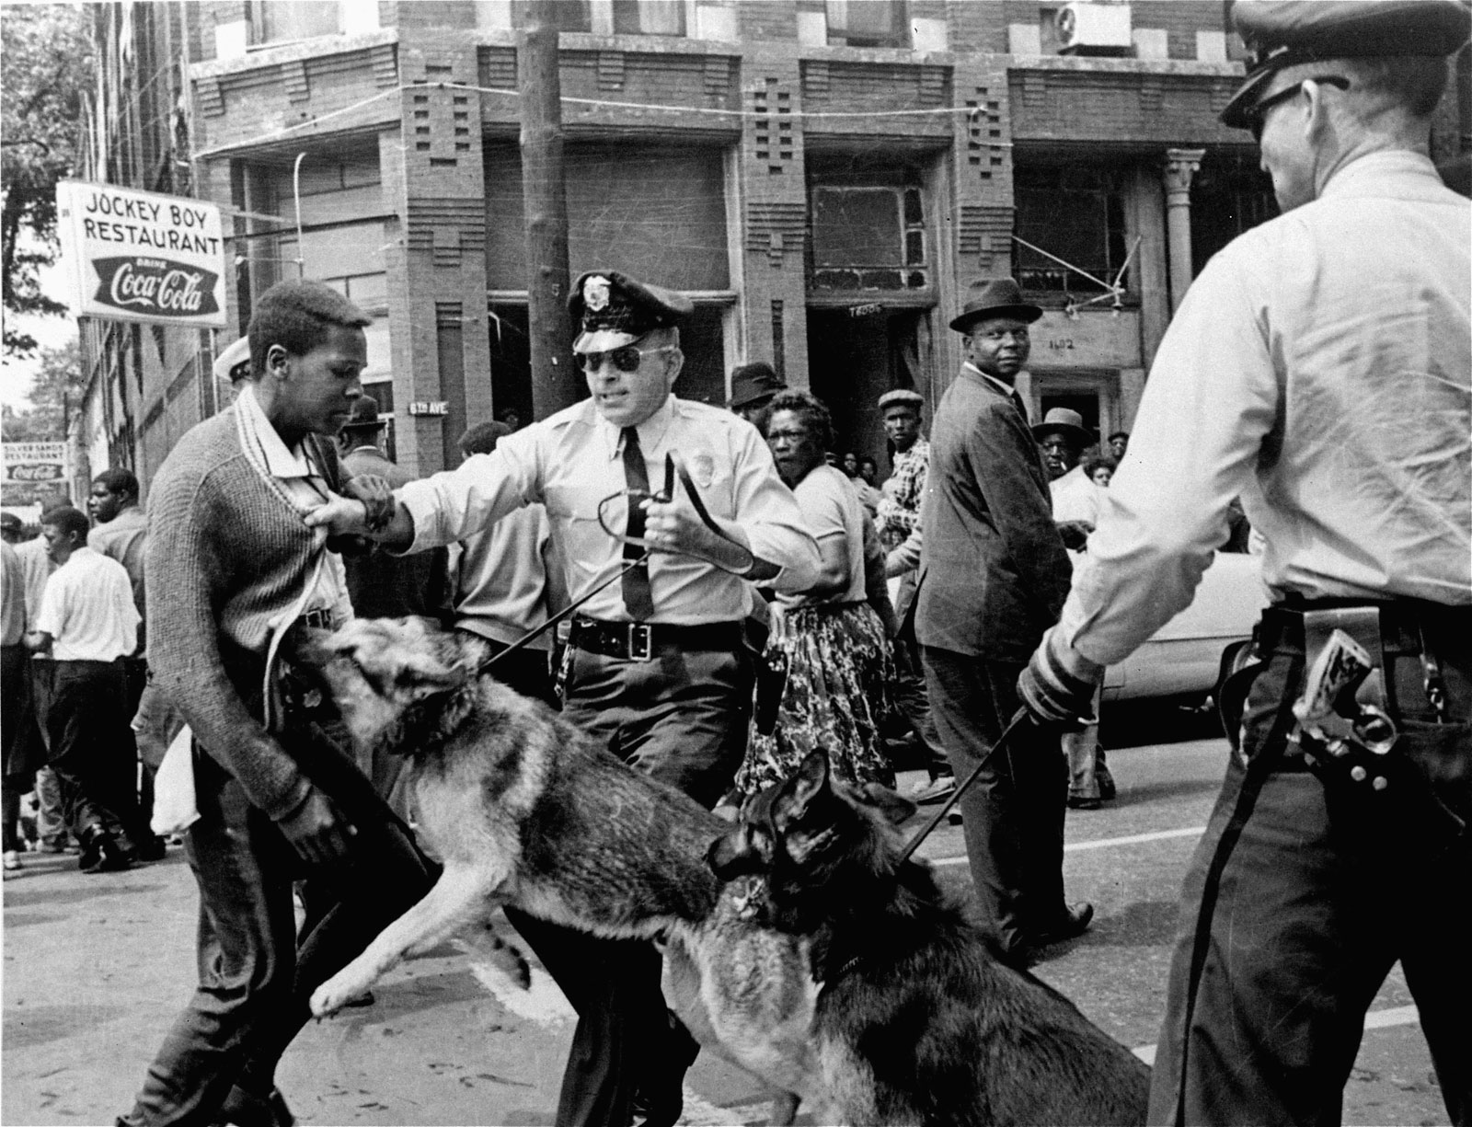

Slide 3
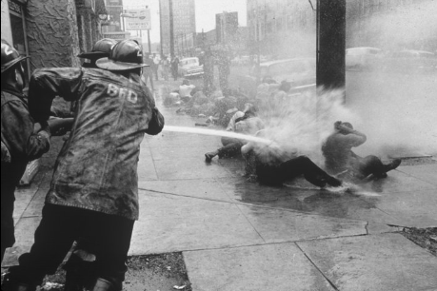

Slide 4
Types of Protests
What are the different ways that people can protest? List 5.

Slide 5
Why do people protest?

Slide 6
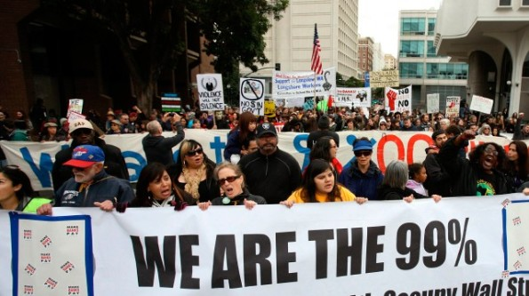
Occupy Movement
In 2011, people all over the world organized to conduct major protests. They were protesting the inequality around the world and the government’s actions that allow the rich to get richer and the poor to get poorer.

Slide 7
Occupy @ UC Davis: Who is at fault?
Students?
Police?
University Chancellor?

Slide 8
Document 1
https://www.youtube.com/watch?v=6AdDLhPwpp4

Slide 9
Document 2
https://www.youtube.com/watch?v=hhPdH3wE0_Y

Slide 10
What should have happened?
If you were in charge of deciding the result of this incident what would you decide?
Who would get a settlement? Students, John Pike, only pepper sprayed students, or some combination?
Should criminal action be taken against anyone?

