Slide 1
Political Philosophies: A Foundation
1/8/15

Slide 2
Bell Ringer- 1/9/15
Silently answer the question on your pink paper.

Slide 3
Agenda
Bell Ringer
SLO pretest
Notes
Primary source analysis
Exit Slip

Slide 4
Objective
SWBAT compare and contrast the beliefs of Thomas Hobbes and John Locke on human nature.

Slide 5
Political Philosophers
John Locke- believed that human nature is good, but people need a strong government to protect them against factions.
Thomas Hobbes- Believed that human nature is bad so people need a strong government to keep them in line.
Baron De Montesquieu- Believed that the separation of powers is a vital part of a government

Slide 6
The State of Nature
A philosophical (not real) place where people are free and there is no law/ government.
Hobbes: believes that this would result in chaos and fighting.
Locke: believes that people would get along just fine.

Slide 7
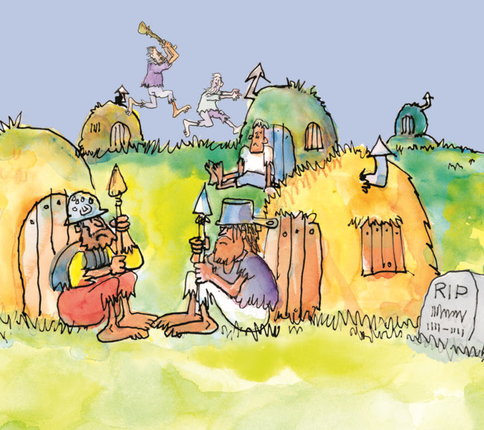
Hobbes or Locke?

