Slide 1
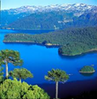
Bell Ringer: describe the picture using
Geographical characteristics.

Slide 2
Standard and EQ
SSWG1 The student will explain the physical aspects of geography.
Describe the concept of place by explaining how physical characteristics such as landforms
Essential Question: How do physical features define a place?

Slide 3
Bell Ringer Review
How many physical descriptors did you use in your paragraph?

Slide 4
Do We Know The World?
Label all of the continents and oceans on your map

Slide 5
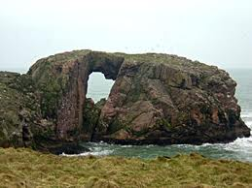
Physical Features
Why do we mainly use physical features to describe a place?

Slide 6
Physical Aspects of Geography
Landforms
Bodies of Water
Natural Resources
Climate

Slide 7
Landforms
Natural structures of the land
Examples: Mountains, glaciers, peninsulas, isthmus, island, plains, plateau, mesa

Slide 8
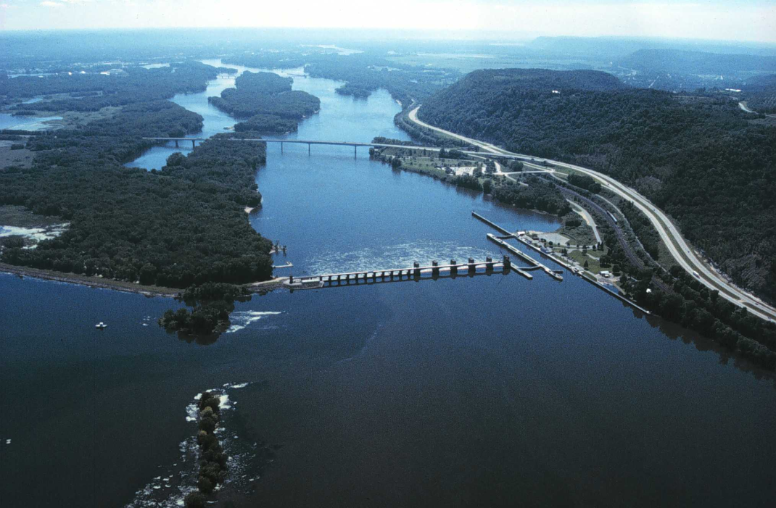
Bodies of Water
Rivers, lakes, seas, oceans
Can provide transportation, fertile soil, fishing, and food, energy from hydroelectric power

Slide 9
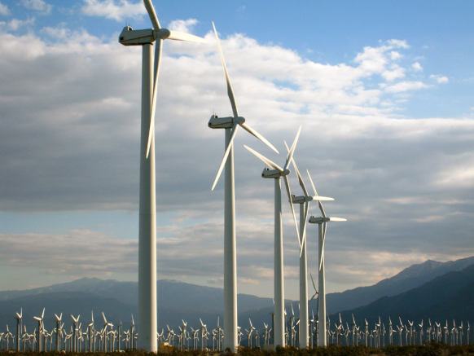
Natural Resources
Substances created naturally by the earth
Coal, oil, diamonds, natural gas
Can bring money to a region or provide essential substances

Slide 10
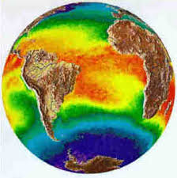
Climate
Tell us the average weather in a place
Can show us if people can live there, what can grow there, and what activities are possible there.

Slide 11
Stop! Let’s Check for Understanding 1 minute

Slide 12
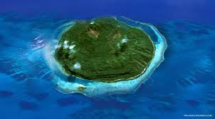
Island

Slide 13
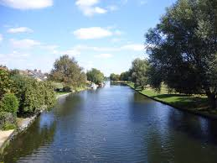
River

Slide 14
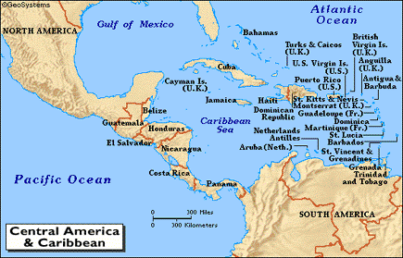
Isthmus

Slide 15
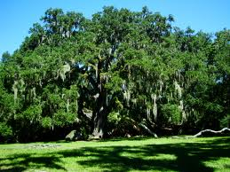
Humid Subtropical
Climate that has mild winters, hot summers, and is typically very humid. This is the climate of Atlanta.

Slide 16
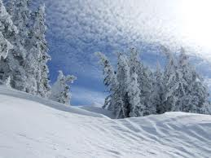
Subarctic

Slide 17
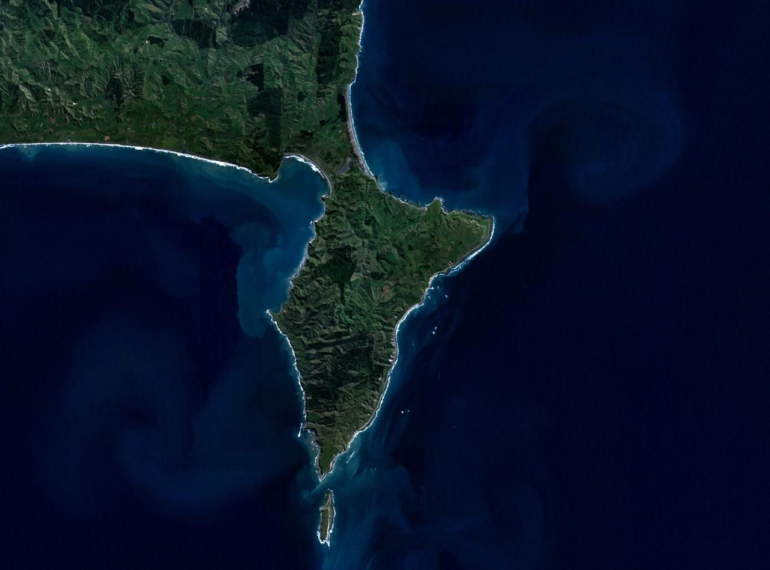
Peninsula

Slide 18
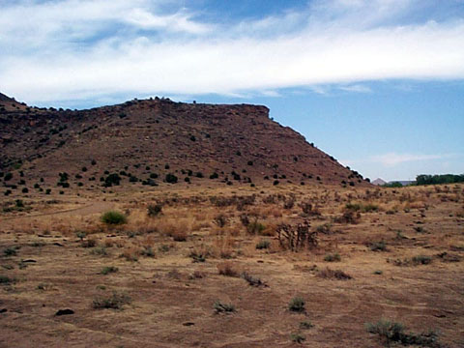
Mesa

Slide 19
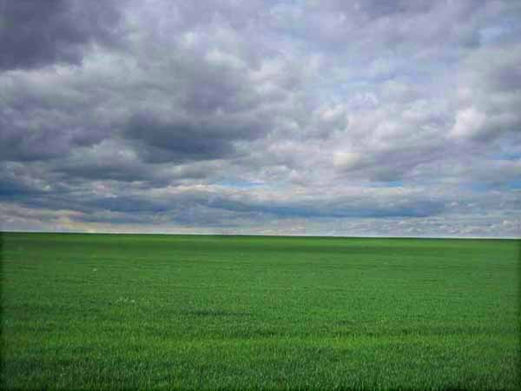
Plains

Slide 20
Ocean

Slide 21
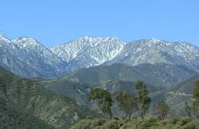
Mountain

Slide 22
Dump and Clump
7 minutes
You and a partner will be assigned the term Landforms, Climate, or Bodies of Water. You will come up with words that relate to that term and then categorize them. You must come up with at least 15 words.

Slide 23
Group Work
Who? Groups of 4 (assigned by me)
What? You will be assigned either Natural Resources, Landforms, Bodies of Water, or Climate. You will make a poster giving at lest 5 examples, an explanation, images, and the impact of your category. You will present this to the class.
When? In the next 35 minutes
Why? So your classmates can learn in depth about the different physical aspects of geography

Slide 24
Exit Ticket
_________ are substances found naturally on the earth that typically bring money to a place.
Natural resources
Landforms
Arctic climate
Rivers
2. ________________ is the climate in Atlanta
Humid continental
Subarctic
Humid subtropical
Mediterranean
3. ______________ is a narrow strip of land that connects two larger strips of land.
Isthmus
Island
Peninsula
None of the above
4. Geographers study landforms because:
They don’t- they’re not that important
They can define the climate and culture of a place
They are pleasing to look at
Each place has the same landforms, so it is easy to study
5. True or False: Climate is the same as weather.

Slide 25
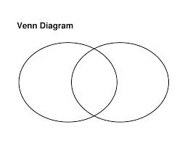
Bell Ringer- Class #4 Aug 12/13
Draw a Venn diagram and compare/contrast Atlanta to a farming town in South Georgia

Slide 26
Standard and EQ
SSWG1 The student will explain the physical aspects of geography.
b. Explain how human characteristics, such as population settlement patterns, and human activities, such as agriculture and industry, can describe a place.
c. Analyze the interrelationship between physical and human characteristics of a place.
EQ- How do physical and human characteristics of geography interact?

Slide 27
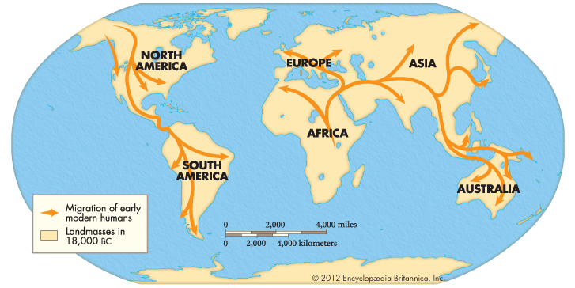
World Human Migrations
https://www.youtube.com/watch?v=hcoOENLfpUI

Slide 28
Close Reading
Together we will read through the descriptions of traits of human geography and annotate as indicated below:
BOX the main idea
UNDERLINE supporting details
CIRCLE any words you don’t know

Slide 29
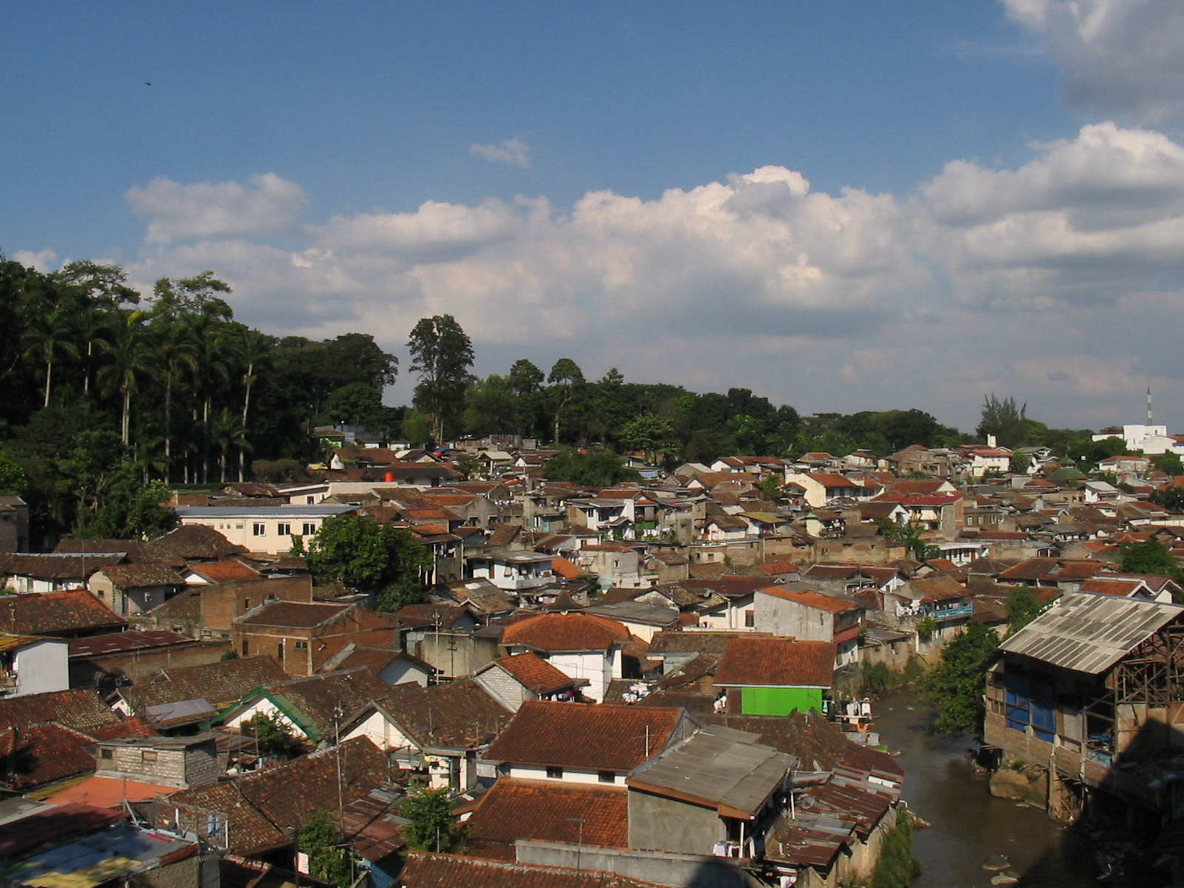
Human Settlement

Slide 30
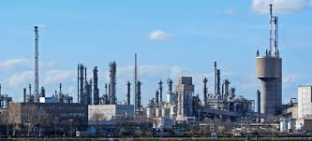
Industry

Slide 31
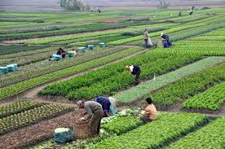
Agriculture

Slide 32
Human Activities

Slide 33
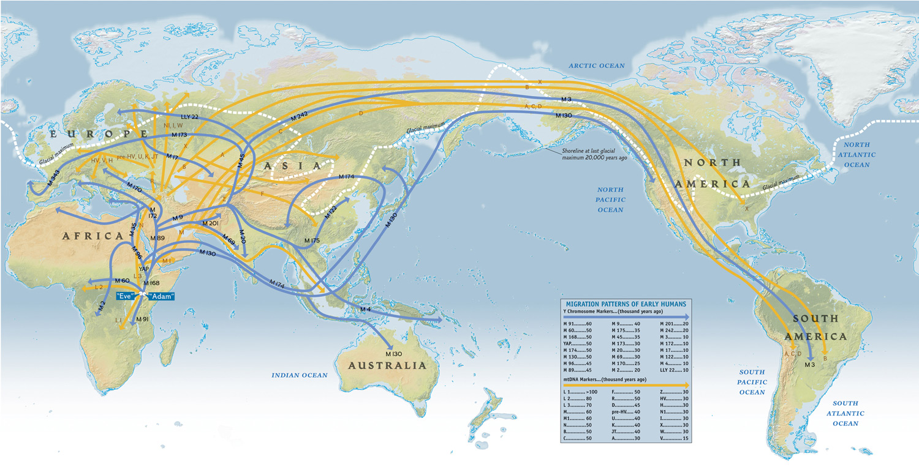
Migration patterns

Slide 35
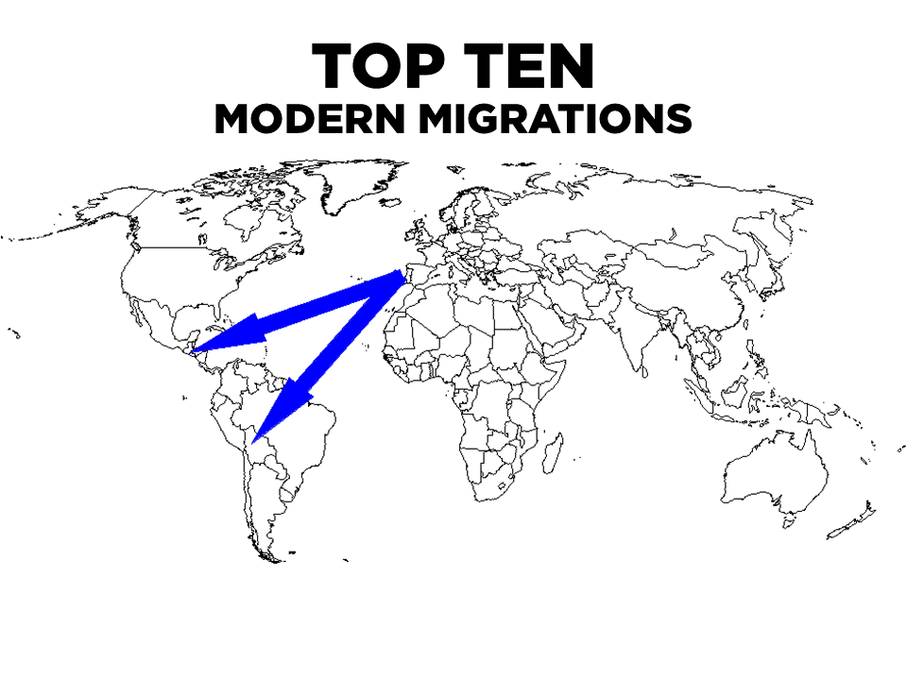

Slide 36
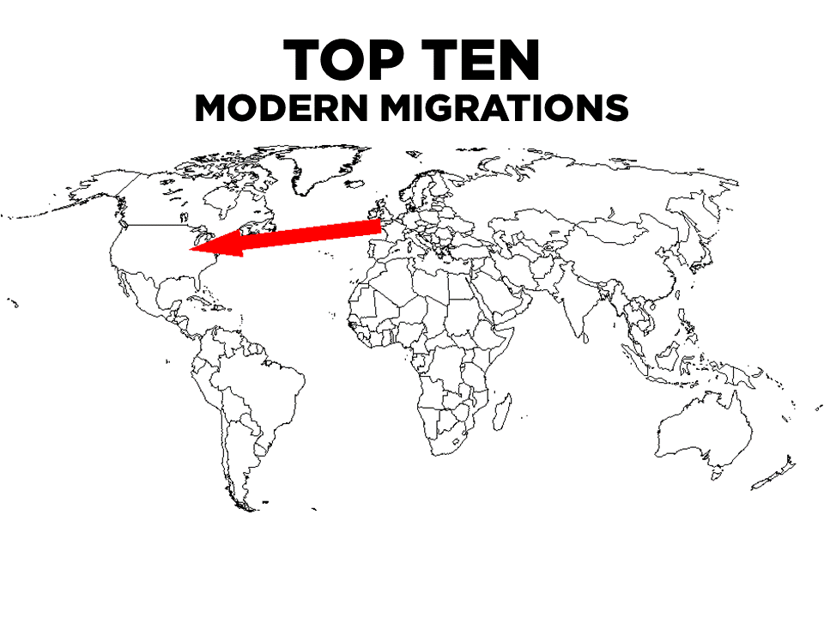

Slide 37
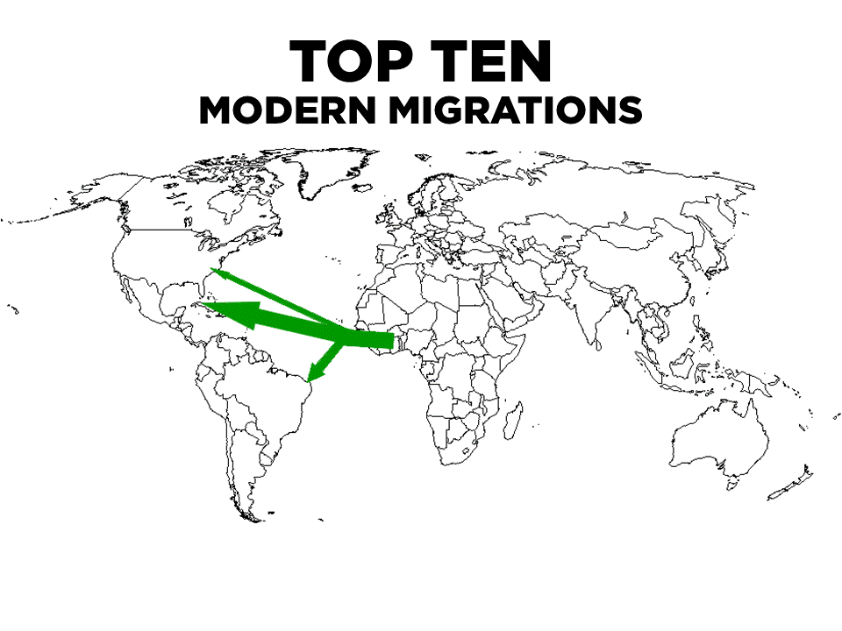

Slide 38
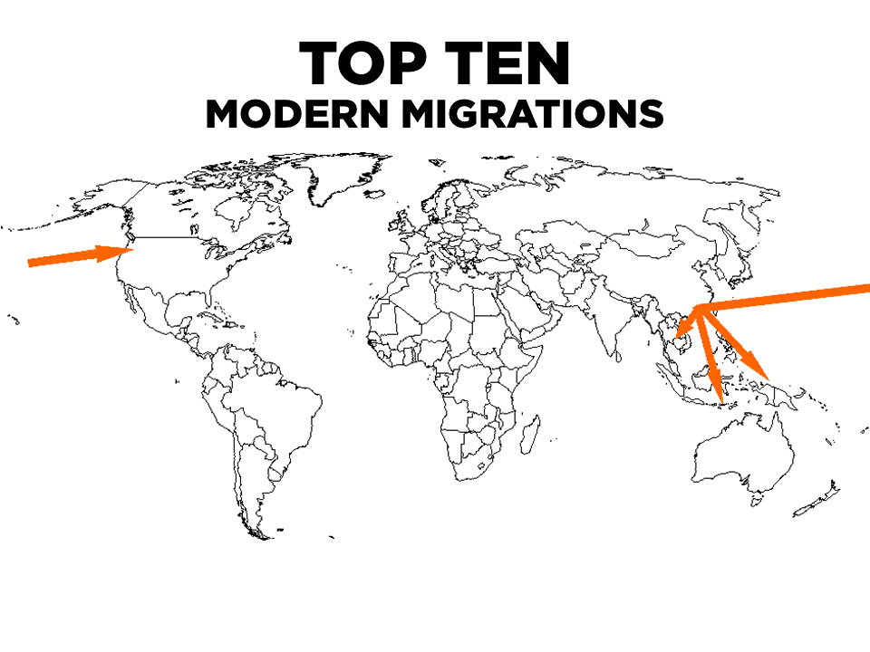

Slide 39
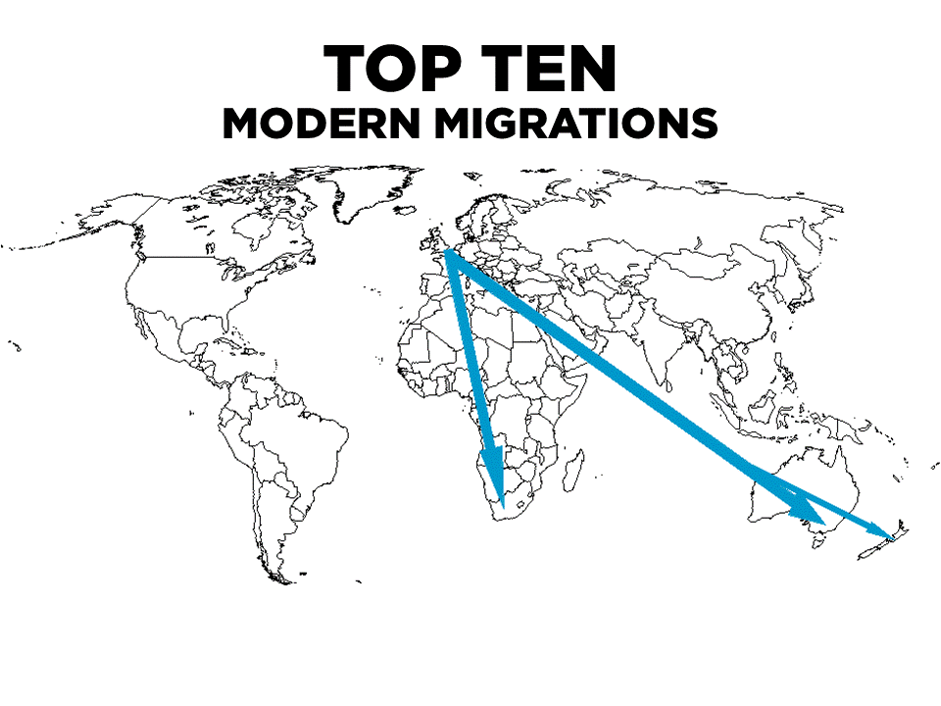

Slide 40
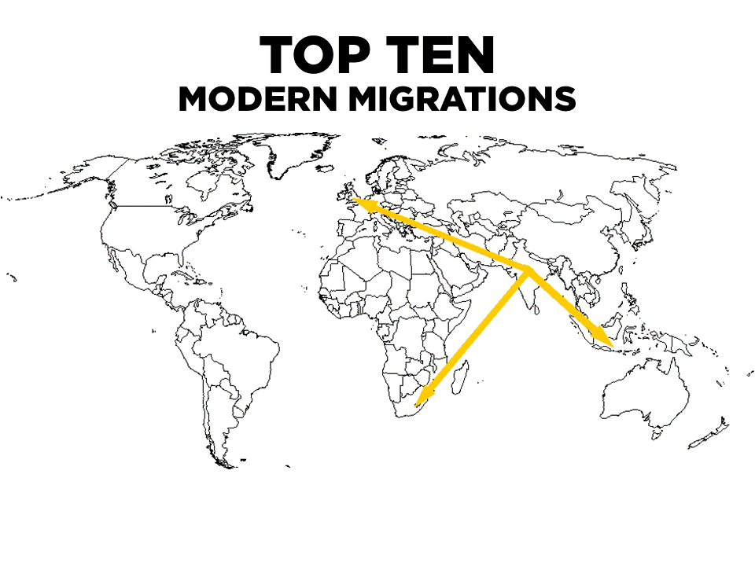

Slide 41
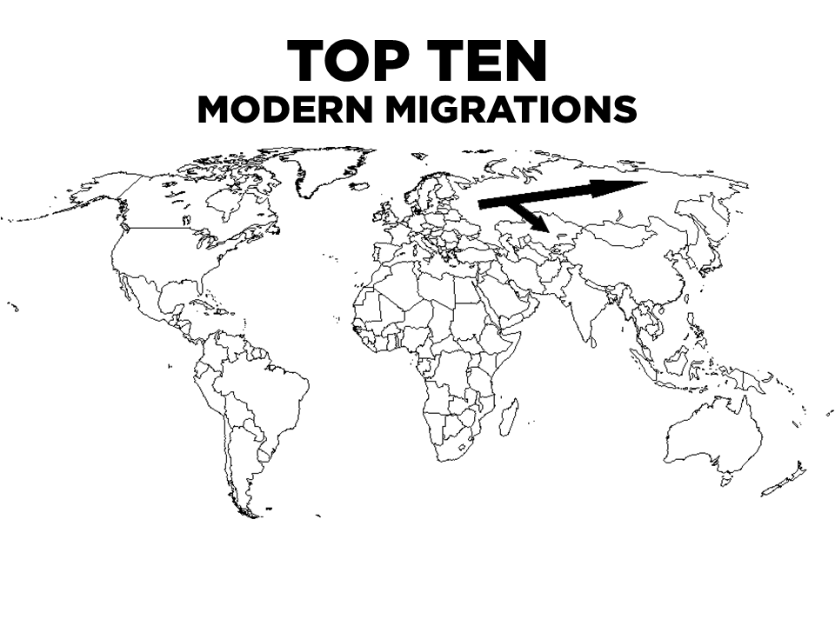

Slide 42
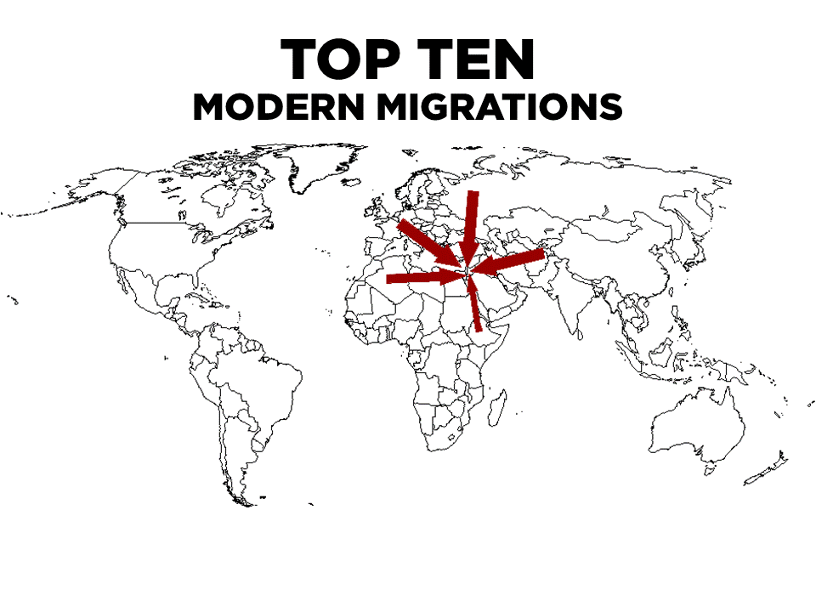

Slide 43
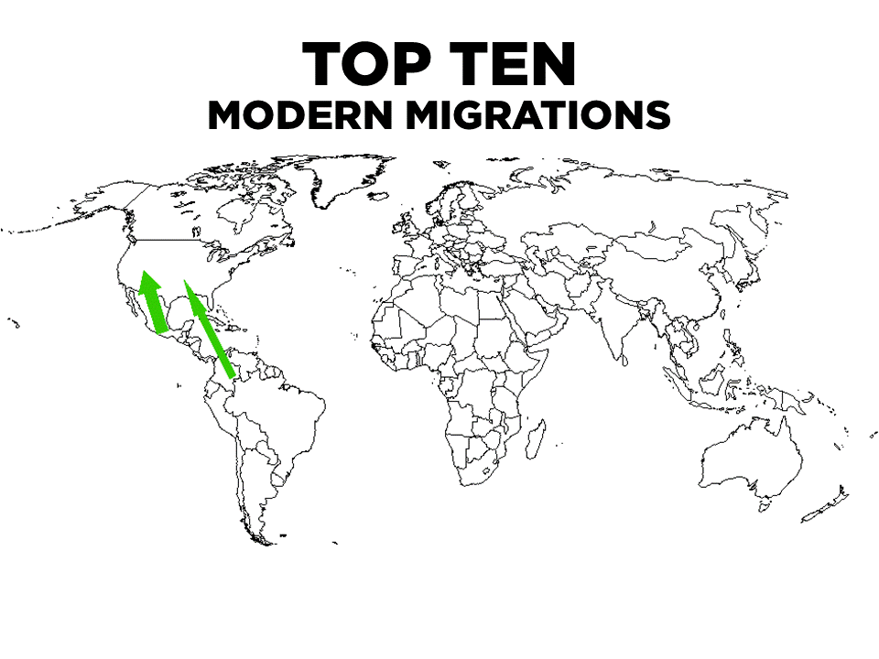

Slide 44
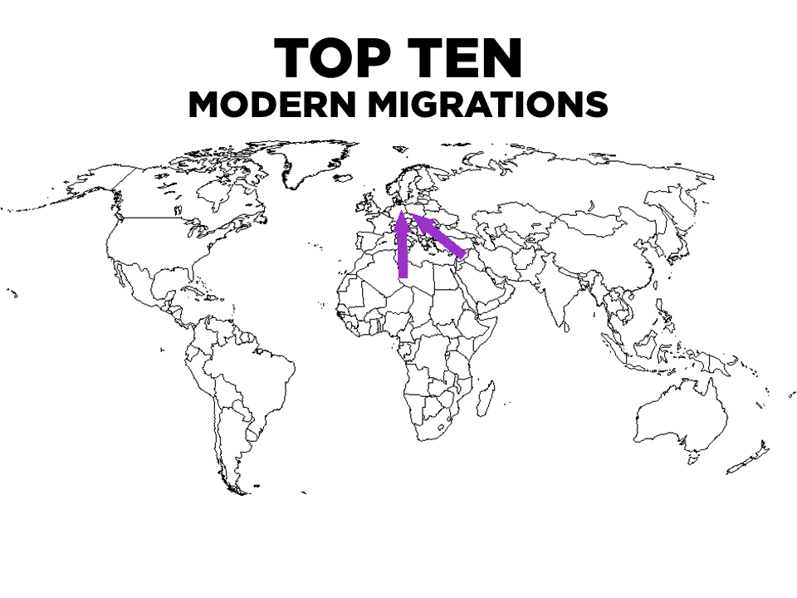

Slide 45
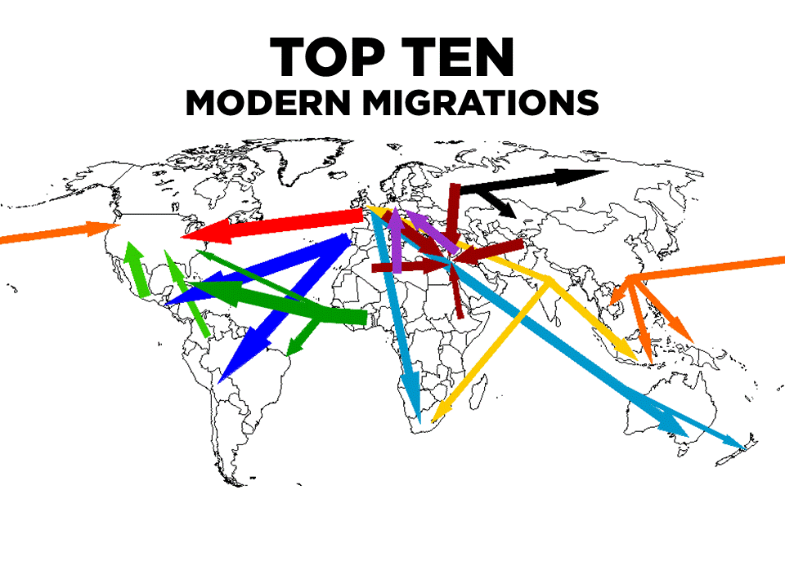

Slide 46
Map Analysis Activity- 25 minutes
In your assigned groups of 4, you will look at the population density map and answer the questions on your worksheet.

Slide 47
Exit Ticket
Populations tend to be higher in:
Inland areas
Coastal areas
Northern Africa
The developing world
2. The migration of people from the Iberian Peninsula to Brazil spread:
Spanish to South America
Portuguese to Brazil
Africans to South America
Slavery
3. Modern intercontinental migrations are significant because:
They have made regions more diverse and spread language
They have spread disease and induced cultural diffusion (the spread of ideas)
They have led to wars and conflict
All of the above
4. Agriculture refers to:
Business
Farming
Coal mining
Grazing animals

