Slide 1
Political Geography 1 and CRQ Review
1/7/15

Slide 2
Final Exam Average
65%

Slide 3
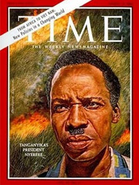
“We must run while they walk”

Slide 4
Semester 2 Goal
80%

Slide 5
Agenda
Quick Review
Binders
Boundaries, States, and Regions
Shapes of States
CRQ practice

Slide 6
Binders
Divider between semester 1 and semester 2
Table of contents for semester 2
HW organizer for semester 2
Must have at least 20 pieces of lined paper at all times

Slide 7
Looking Ahead
1/7- Political Geography 1
1/9- Political Geography 2
1/13- Political Geography 3 (quiz)
1/15- Political Geography 4 and review
1/19- Unit 6 Exam

Slide 8
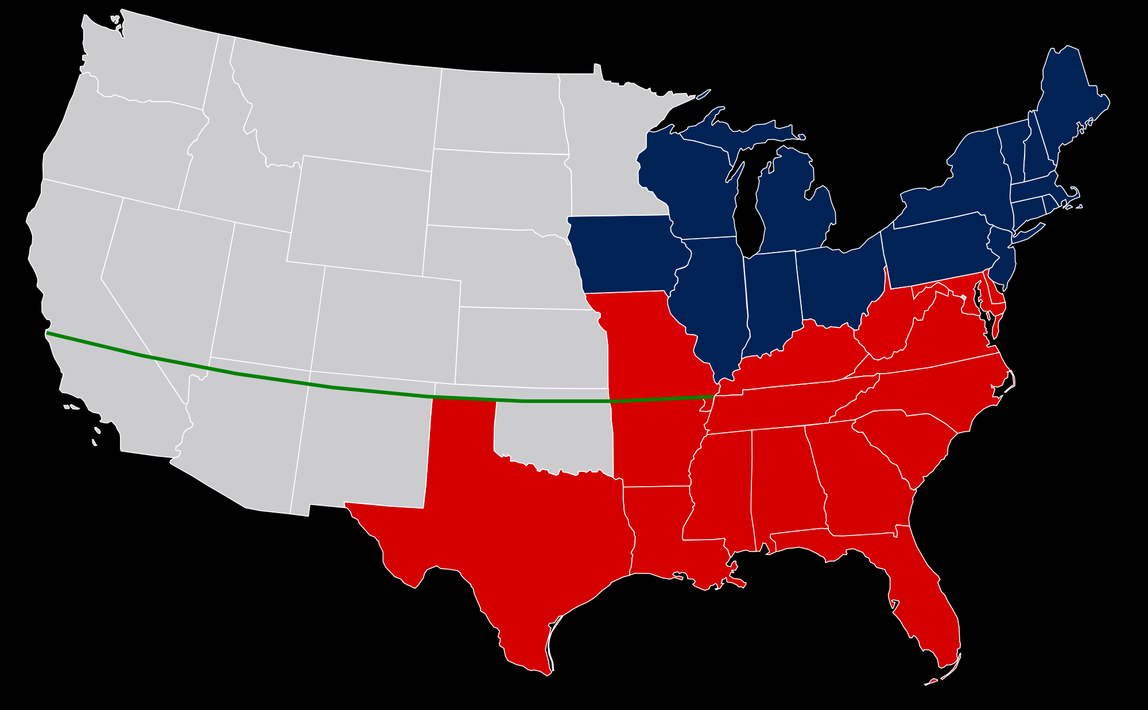
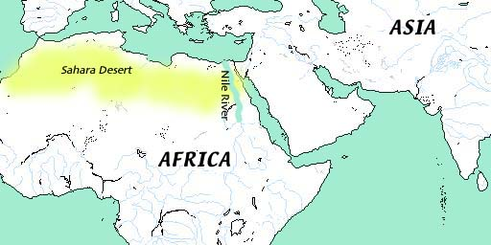
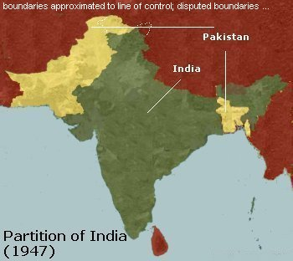
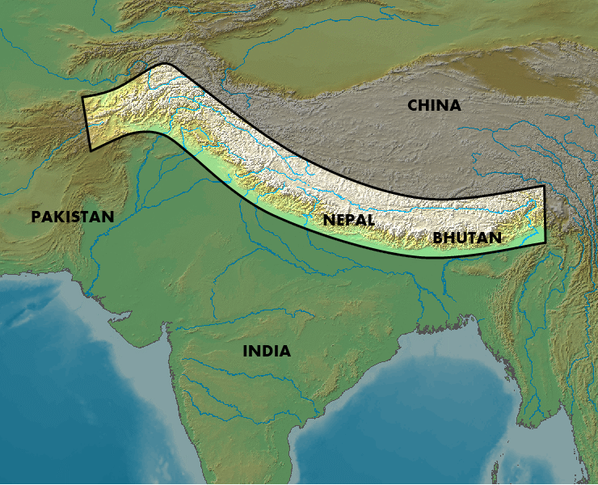
Types of Boundaries

Slide 9
CRQ Guidelines
Underline key words/phrases in the question itself. Circle specific requirements of the question.
Jot down key terms/vocabulary/examples/etc. that will be a part of your response in the blank space below the question. These preliminary notes will not NOT be graded. Only your formal response will be graded.

Slide 10
CRQ Guidelines
3. Make a list of ideas – did the question ask for 3 examples? List MORE in your preliminary notes – and then choose your best ideas and work with them and ONLY THEM
4. Answer the question in the order it is asked. If the question is organized “A., B., C.,” answer it “A., B., C.” Label the parts of your answer

Slide 11
CRQ Guidelines
5. A formal introduction is NOT needed, launch right into your answer.
6. Answer each section of the question COMPLETELY. When you have answered a part of the question (which you have underlined or circled) cross it off
7. Be specific and state things you think are obvious. Do NOT assume the reader is an expert in the topic. Explain any abbreviations or acronyms

Slide 12
Command Terms
IDENTIFY | State a clear, concise, and specific answer.
DEFINE | Give the precise meaning or basic qualities of something.
DESCRIBE | Provide a representation in words of the basic attributes or characteristics.
EXPLAIN | Give a detailed account, by offering reasons or adding details, to make something plain.
DISCUSS | Offer a considered review which may include explanations, examples, arguments, factors, and additional evidence.

Slide 13
Exit Ticket – 5 minutes
Answer the following questions in complete sentences on lined paper without using your notes.
Describe one possible shape of a state and the pros and cons of that shape.
When answering a CRQ, what is the first thing that you should do and why?

