Slide 1
The Declaration of Independence
1/12 & 1/13

Slide 2
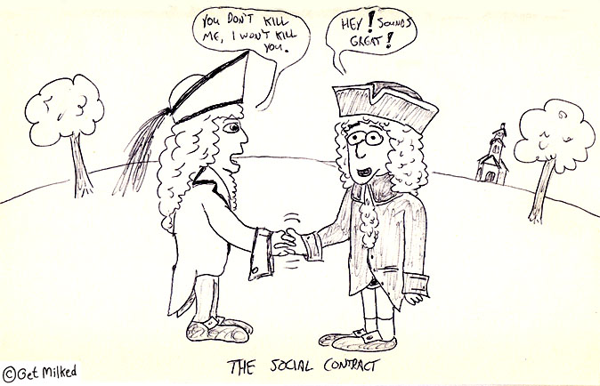
Bell Ringer
Silently answer the questions on your pink paper about this political cartoon.

Slide 3
Today’s Objective
SWBAT describe the purpose of the Declaration of Independence and evaluate it as a persuasive essay.

Slide 4
5 minute partner work
Decide on a list of 5 complaints with your partner and write a letter or bulleted list of complaints that you both agree are the most important.

Slide 5
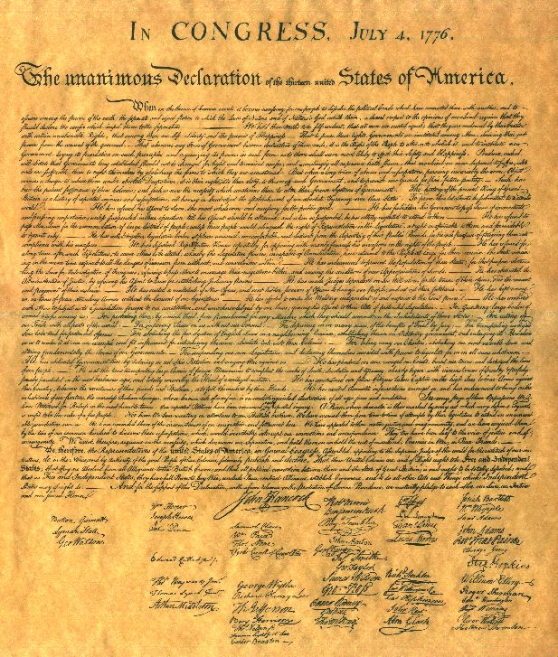
The Declaration of Independence
Fast Facts:
Gave the colonies freedom from England
Listed complaints to the King of England (George III)
Ratified (passed) on July 4th 1776

Slide 6
Declaration of Independence Excerpts
Read and analyze the excerpts of the Declaration of Independence on the back of your sheet. Whispering very quietly with the person next to you.

Slide 7
Write Your Own D of I
Write your own break up letter in the same format as the Declaration of Independence.
-expectations
-why you’re upset
-break up with them

Slide 8
Exit Slip
Answer the following question in 4-6 sentences.
How is the Declaration of Independence a good example of a social contract?

