Slide 1
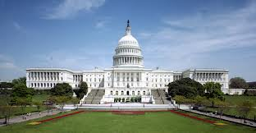
The Legislative Branch

Slide 2
Bell Ringer
Answer the multiple choice questions on your pink paper.

Slide 3
Topic
IS the American Jury system still a good idea?

Slide 4
Test Item Analysis
Highlight standards we have covered
Create Test Score Graph
Plot your score on your bar graph

Slide 5
Today’s Objective
SWBAT compare and contrast the Senate and House of Representatives. (SSCG9)

Slide 6
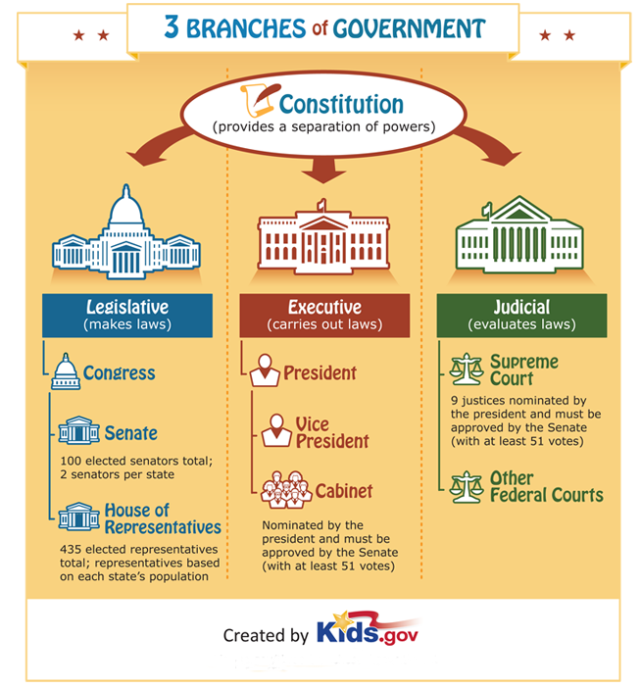
Video Guide
https://www.youtube.com/watch?v=mt5K4ZK0ILY

Slide 7
House Vs. Senate
Use your documents to fill in the chart on the back of your paper.

Slide 8
Team Task
Option 1: Create a Venn diagram of the House of Representatives Vs. the Senate on chart paper
At least 5 bullets in each bubble and 3 on the outside.
Option 2: Create 3 multiple choice questions about the House of Representatives and Senate on chart paper.

Slide 9
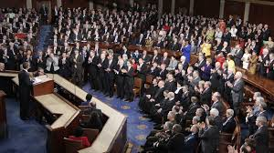
Diversity in Congress
Read article and highlight statistics
Fill in the chart on the back
Answer question on the back

