Slide 1
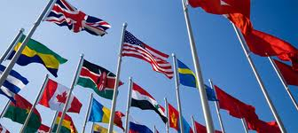
United States Foreign Policy
11/15/13

Slide 2
Bell Ringer
You and a friend are in a corner store. Your friend steals a bag of chips without realizing there are cops outside. You guys run out of the store and sprint as fast as you can. You lose the cops but it is really close and you almost got caught.
What would you say / do to your friend once you got away?

Slide 3
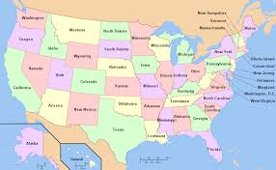
Beginning of American History
Mostly concerned with domestic affairs
Policy of isolationism- refusing to be involved in affairs of the rest of the world

Slide 4
A little History
Monroe Doctrine- Isolated the US from international affairs (isolationism)
Truman Doctrine- states that the US will oppose any threat made to the US (internationalism)

Slide 5
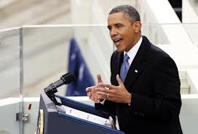
US Foreign Policy
Key Players:
United States President
Secretary of State
Secretary of Defense
Head of Intelligence organizations (CIA)
Foreign Ambassadors/ Diplomats

Slide 6
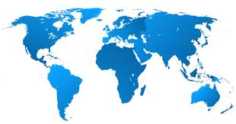
Foreign Policy
Includes all actions a nation can take when dealing with other countries

Slide 7
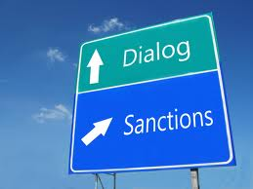
Sanctions
A penalty Imposed for some hostile act

Slide 8
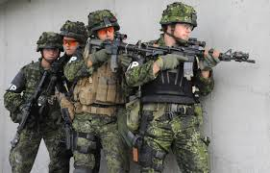
Military Action
Using our armed forces to strike a country

Slide 9
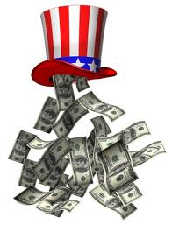
Aid
Military Aid- joining forces
Economic Aid- giving money
Humanitarian Aid- becoming allies to fight an injustice or praise a good decision

Slide 10
Treaties
Written agreement between two or more countries
i.e. NATO (North Atlantic Treaty Organization)
-originally created to stop the spread of communism
-main focus now is crisis management and peacekeeping

Slide 11
2 minutes
Silently answer the 4 multiple choice questions on the bottom of your sheet

Slide 12
HOT SEAT
5 people are in the “hot seat.”
If you are one of them then you need to read the scenario and tell the class what foreign policy tactic you would take and why. If you decide to PASS then you have to choose someone and you lose 5 points today on classwork.
Other options: Ask a friend for help, poll the audience

Slide 13
Work Time
Think of a global issue (hunger, poverty, child labor, human trafficking, genocide etc)
Come up with a name for an international organization that would help fix that issue
Create a paper website or brochure for your organization. Make sure to write down who started it and why and how it can help the world. Also, make sure to write why the United States should join.

