Slide 1
AP Human Geography
Ms. Browne Fall 2014

Slide 2
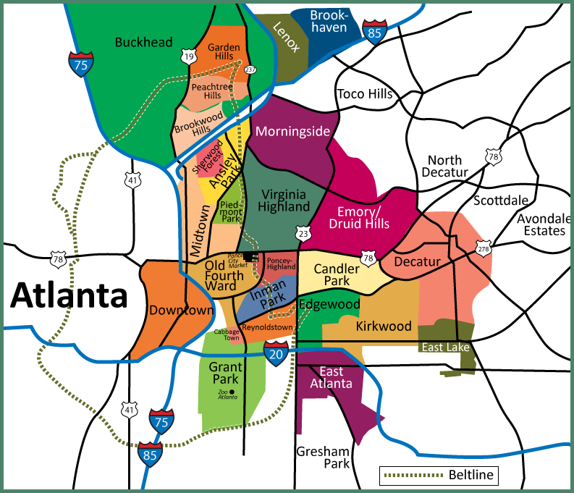
Themes of Geography

Slide 3
Themes in Geography
Place
Location
Region
Movement
Human/Environmental Interaction
Space
Scale

Slide 4
PLACE
Place: a Unique Location
What is it like there? What makes this place different from others?
-A toponym is the name given to a place on Earth
-Site refers to the physical character of a place
-Situation- location of a place relative to other places

Slide 5
Location
Where is it? Absolute location? Relative Location?
EX. The house is located at 432 Peachtree St. NE
EX. The house is next to the gas station
Which is describing absolute location? Which is describing relative location?

Slide 6
REGION
Region
What makes this place similar to other areas?
Formal (uniform region)- everyone shares in common one or more characteristics
Functional (nodal) region- organized around a node or focal point
Vernacular (perceptual) region- Similar cultural identities. Informal sense of place rather than scientific models.

Slide 7
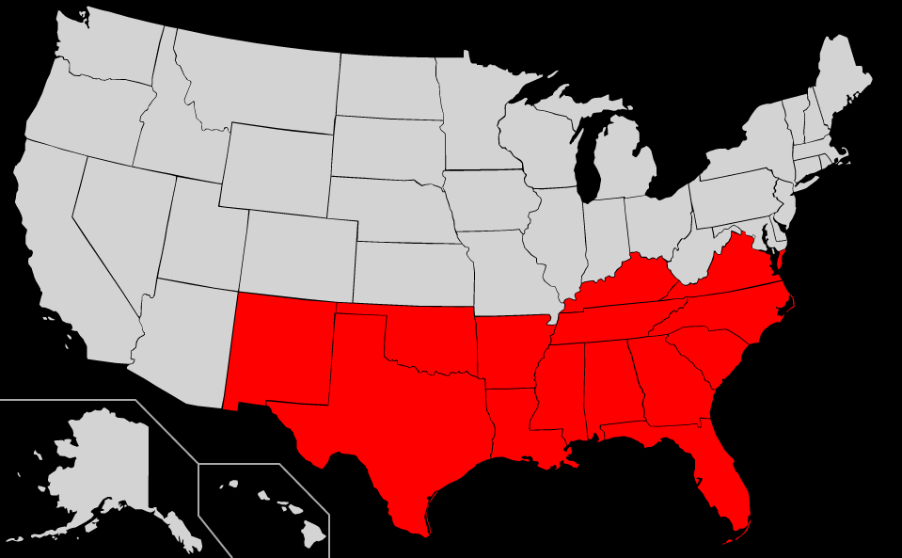
REGION EXAMPLE
The South. Take 5 minutes and list 5 characteristics of the South.

Slide 8
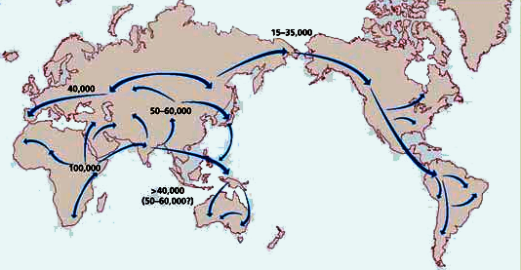
MOVEMENT
How do people get around? How do ideas get around?
Migration – people moving from one country or region to another
Cultural Diffusion- the spread of ideas through travel, media, or education.
Relocation Diffusion- Something that originates at a hearth (starting point) and spreads across space through human movement
Expansion diffusion- The spread of a feature from one place to another through hierarchical diffusion, contagious diffusion, or stimulus diffusion (well come back to this later)

Slide 9
HUMAN/ENVIRONMENT INTERACTION
Renewable and Nonrenewable resources
Renewable- produced by nature more rapidly than it is consumed by humans
Nonrenewable- produced in nature more sowly than it is consumed by humans
Pillars of Sustainability – The Key to sustainable success
The Environment Pillar- The sustainable use and management of the Earth’s resources to meet human needs (conservation)
The Economy Pillar- Consumers should pay for their pollution and use of nonrenewable resources
The Society Pillar- Society’s values must change on the basis for choosing what kinds of resources to use

Slide 10
SPACE
Physical gap between two objects
Density- frequency with which something occurs in space
Concentration- the extent of a feature’s spread over space. Clustered VS. Dispersed.
Pattern- Geometric arrangement of objects in space. I.e. linear (subway systems), square/rectangular/grid (cities).

Slide 11
SCALE and PROJECTION
Reading activity

Slide 12
DIAGNOSTIC TEST
Diagnostic test- You will get 100 points for a quiz grade if you complete this test and take it seriously. Treat this like it is a real test because it will help me to teach you best!

